Slide 1
Decision Tree
Xiaochun MAI
Shenzhen University

Slide 2
Outline
Multiclass Classification
Decision Tree

Slide 3
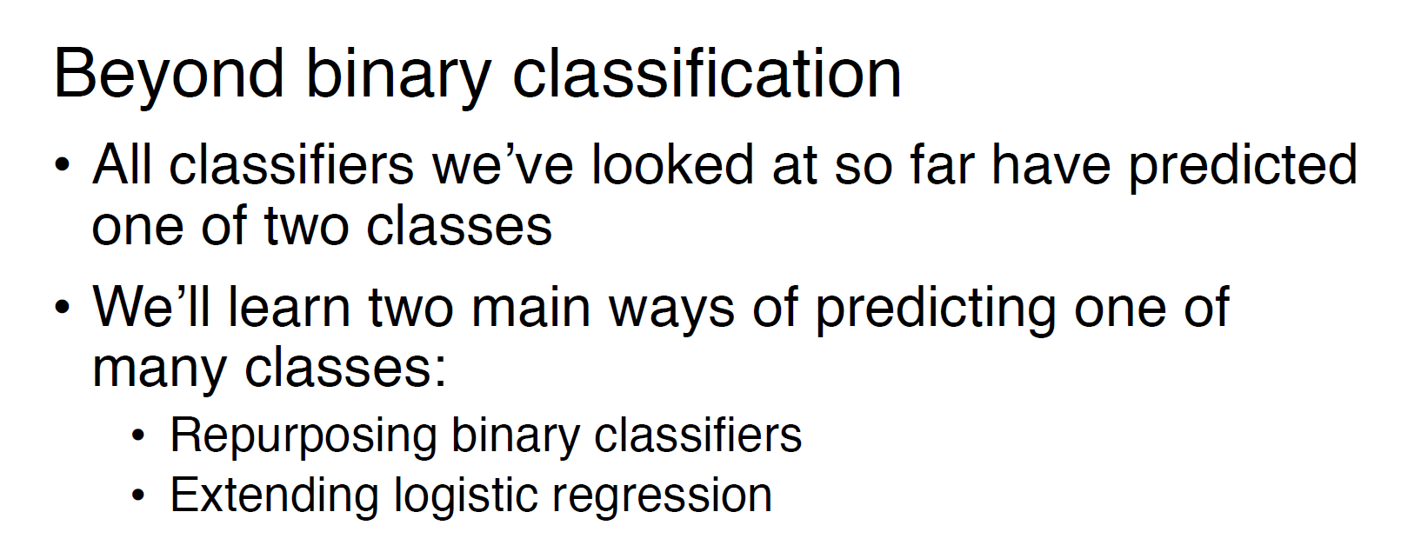
Multiclass Classification
Notes:
We need to combine all the

Slide 4
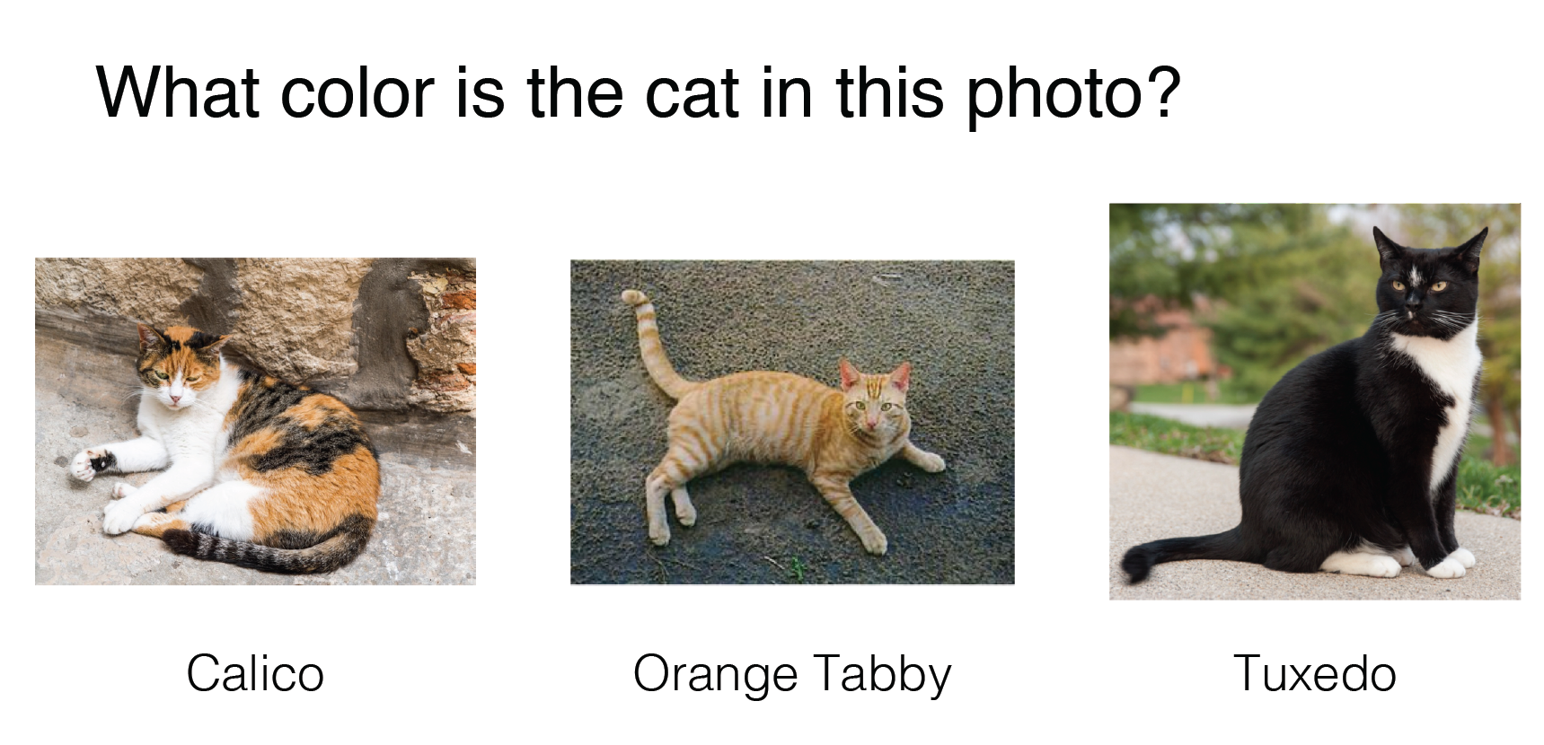
Multiclass Classification
Notes:
We need to combine all the

Slide 5
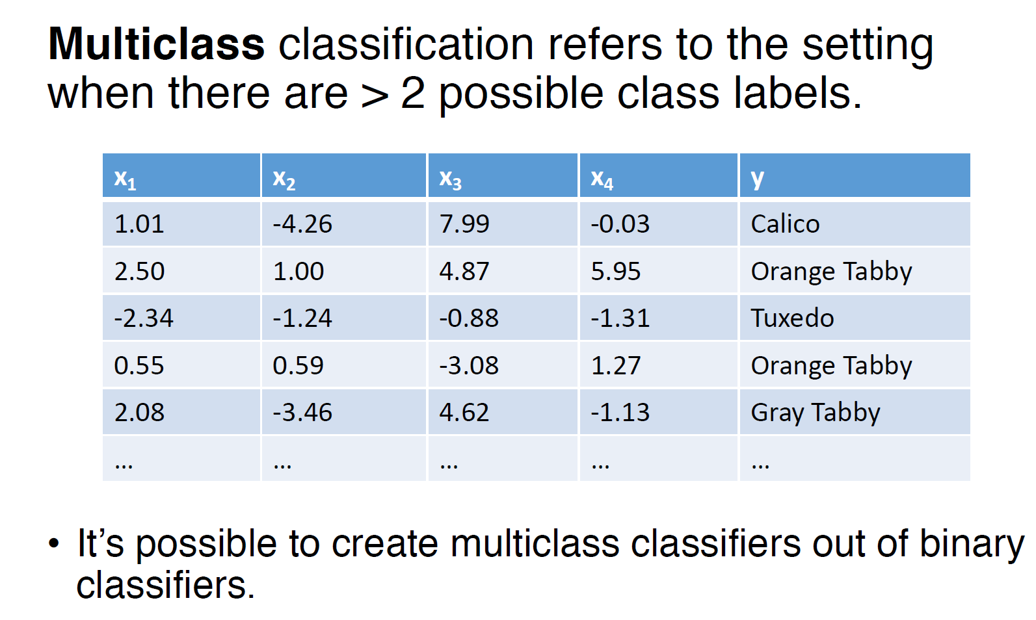
Multiclass Classification
Notes:
We need to combine all the

Slide 6
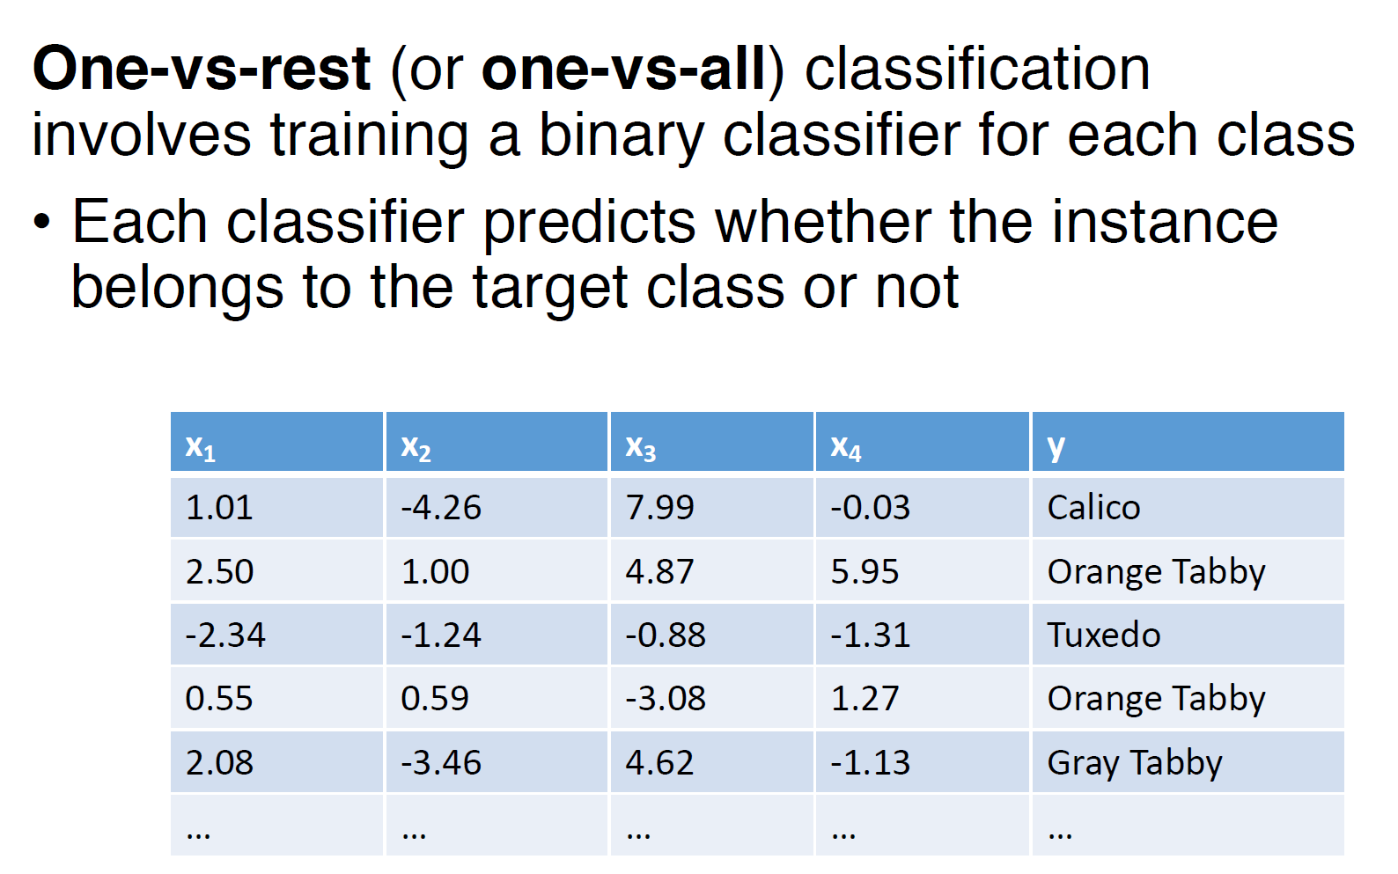
One versus Rest
Notes:
We need to combine all the

Slide 7
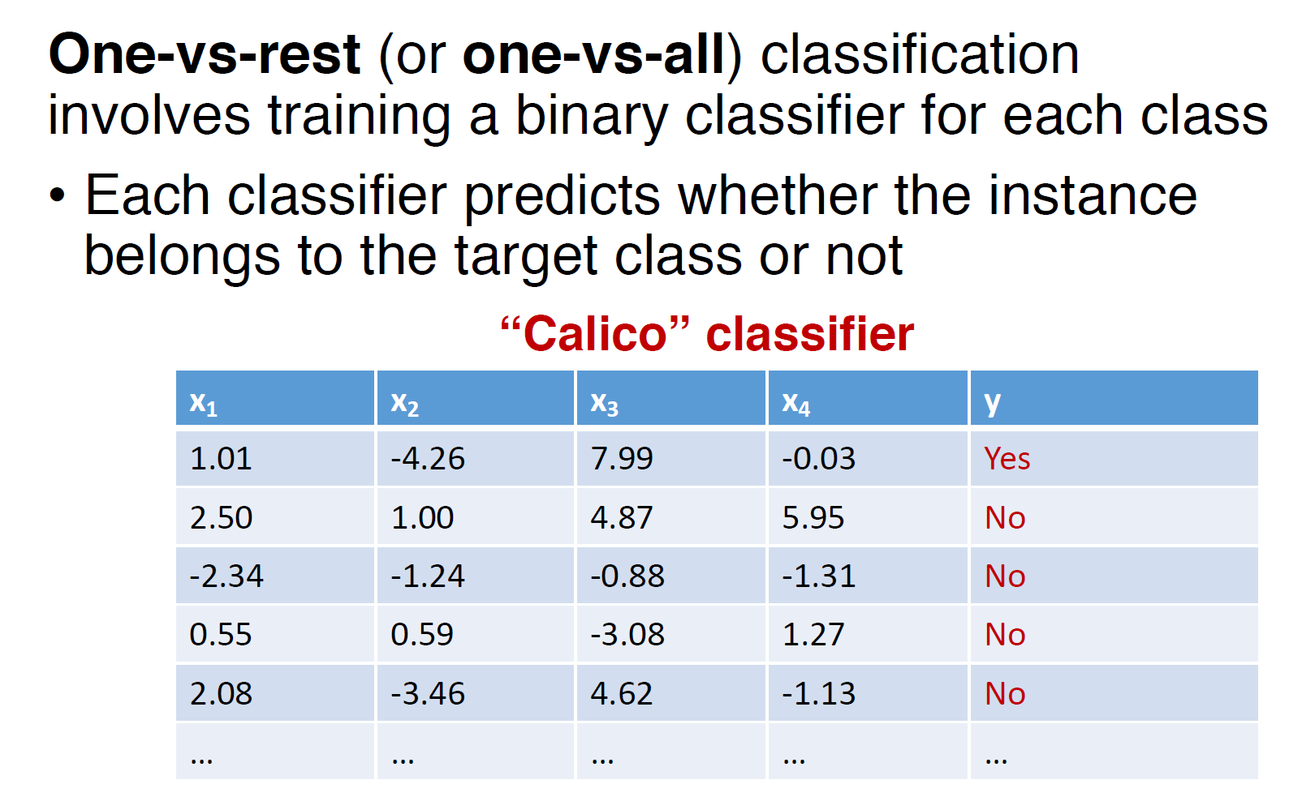
One versus Rest
Notes:
We need to combine all the

Slide 8
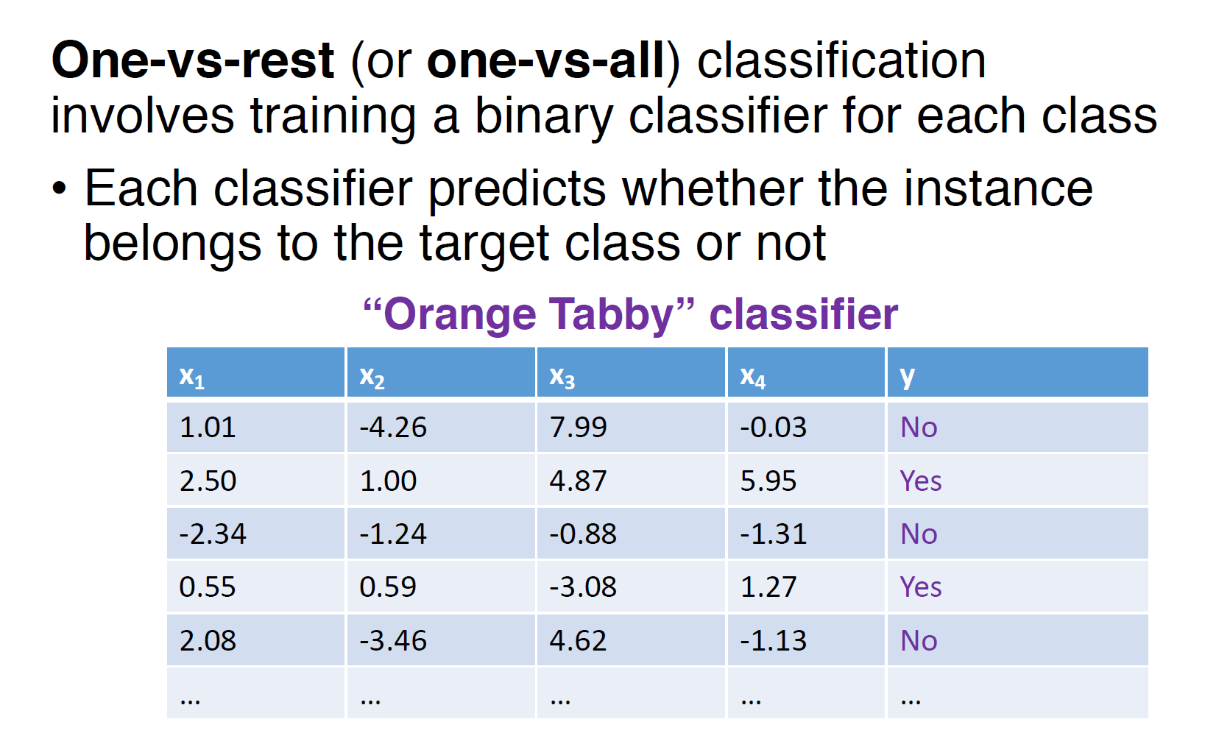
One versus Rest
Notes:
We need to combine all the

Slide 9
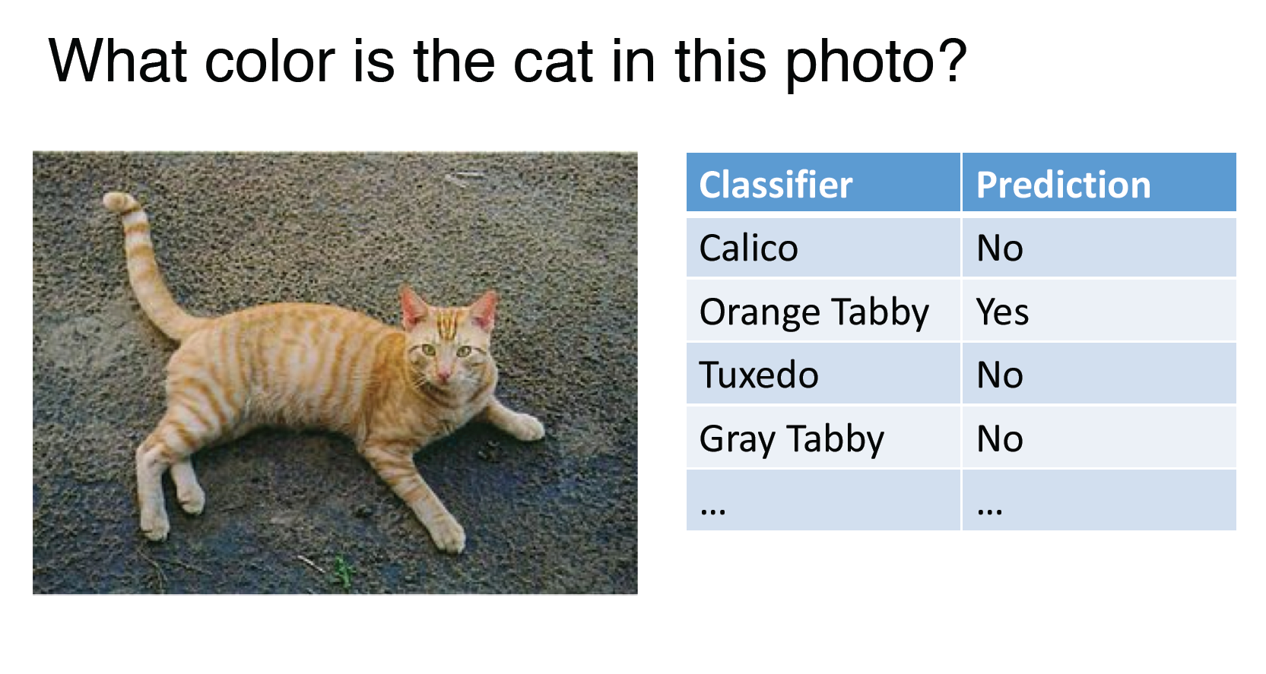
One versus Rest
Notes:
We need to combine all the

Slide 10
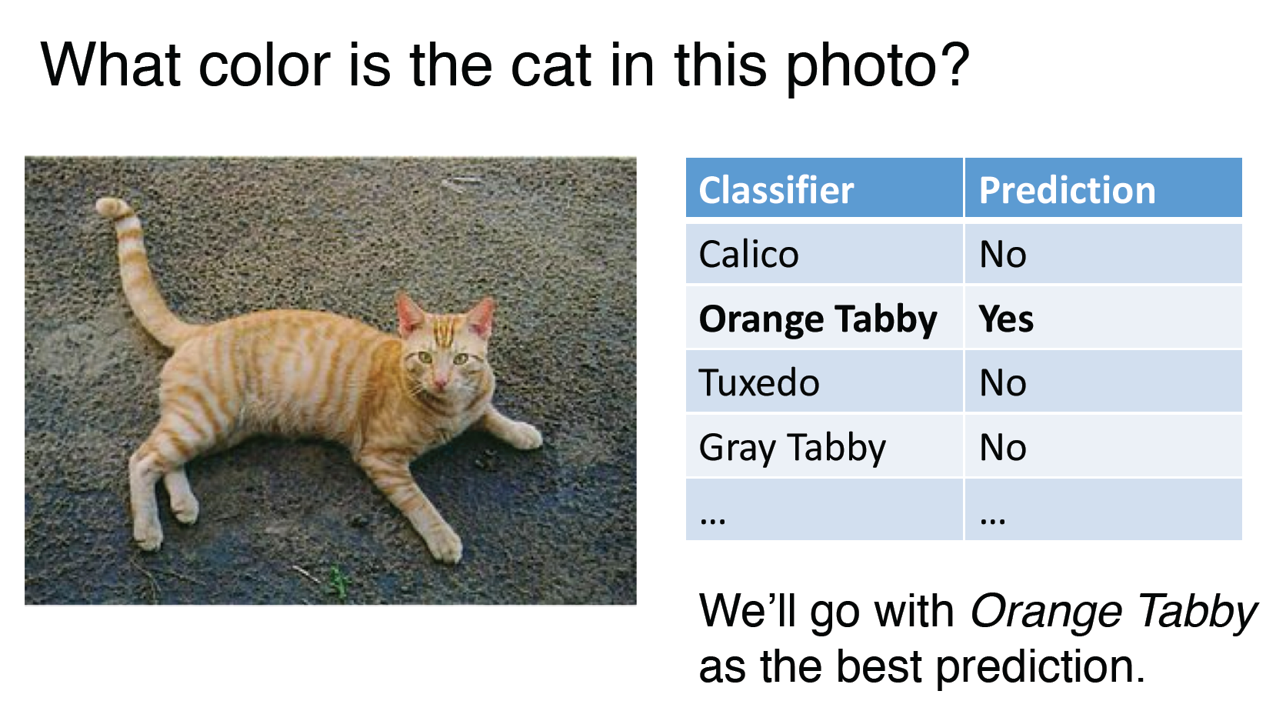
One versus Rest
Notes:
We need to combine all the

Slide 11
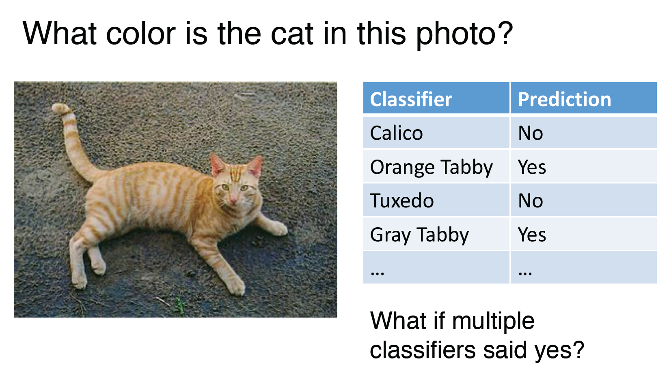
One versus Rest
Notes:
We need to combine all the

Slide 12
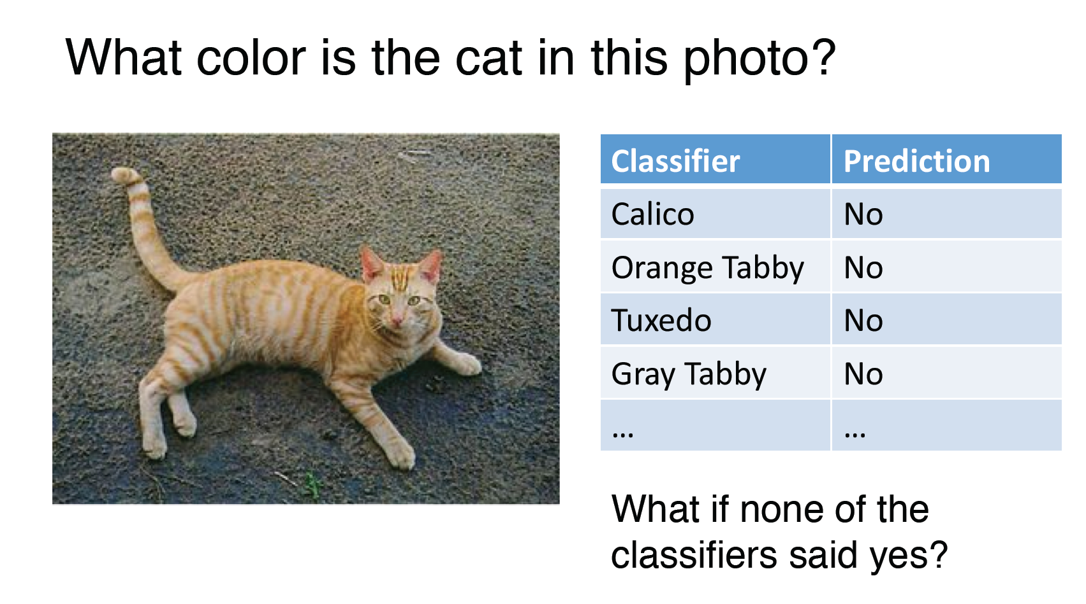
One versus Rest
Notes:
We need to combine all the

Slide 13
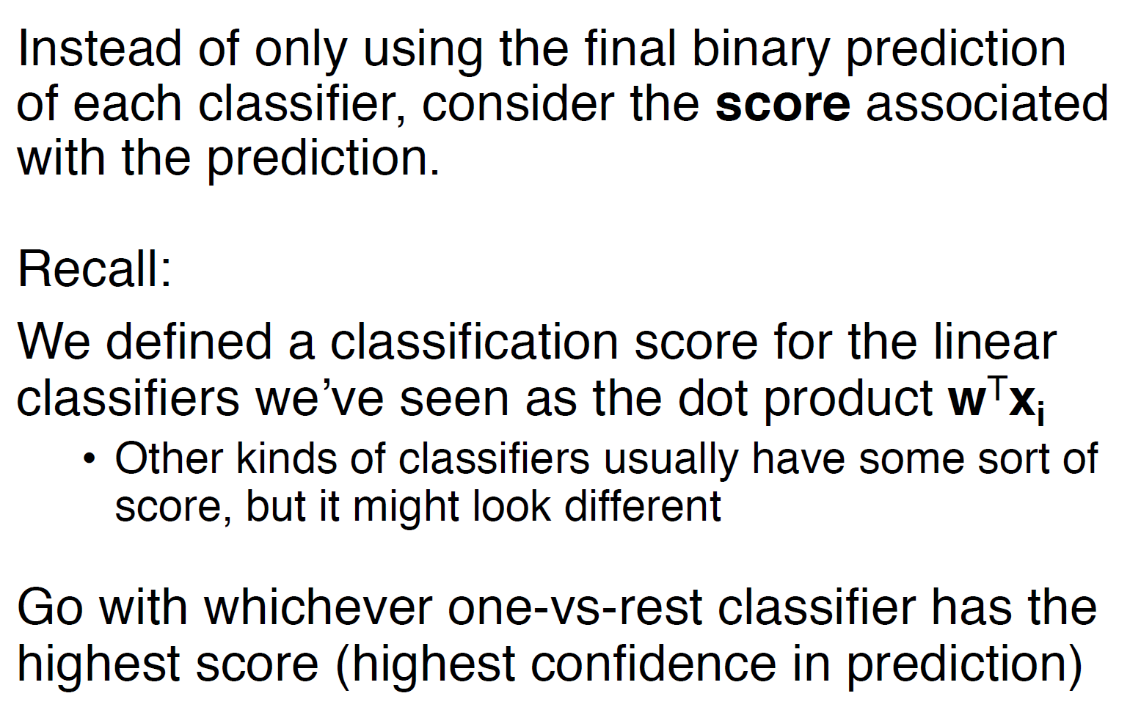
One versus Rest
Notes:
We need to combine all the

Slide 14

One versus Rest
Notes:
We need to combine all the

Slide 15
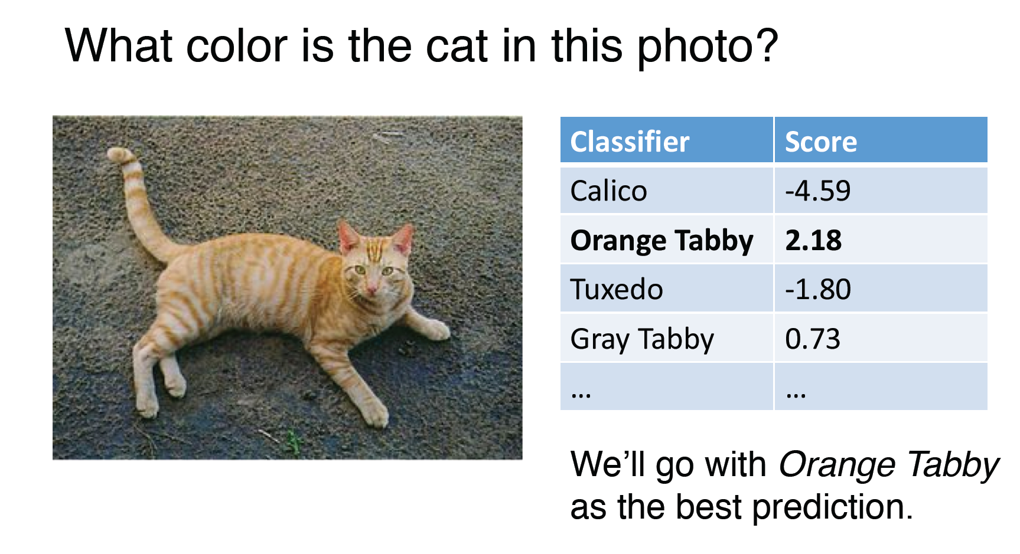
One versus Rest
Notes:
We need to combine all the

Slide 16
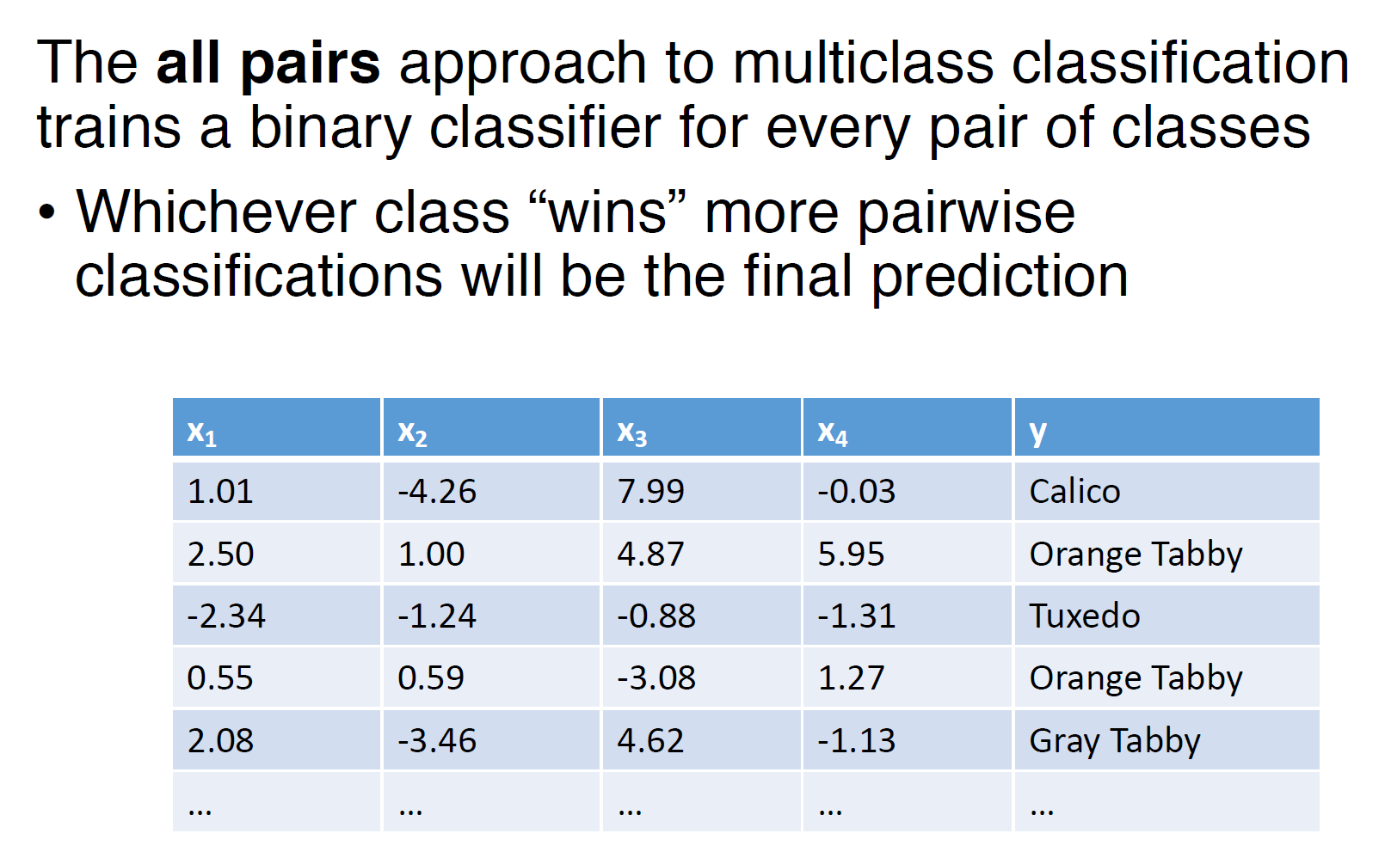
All Pairs (One vs One)
Notes:
We need to combine all the

Slide 17
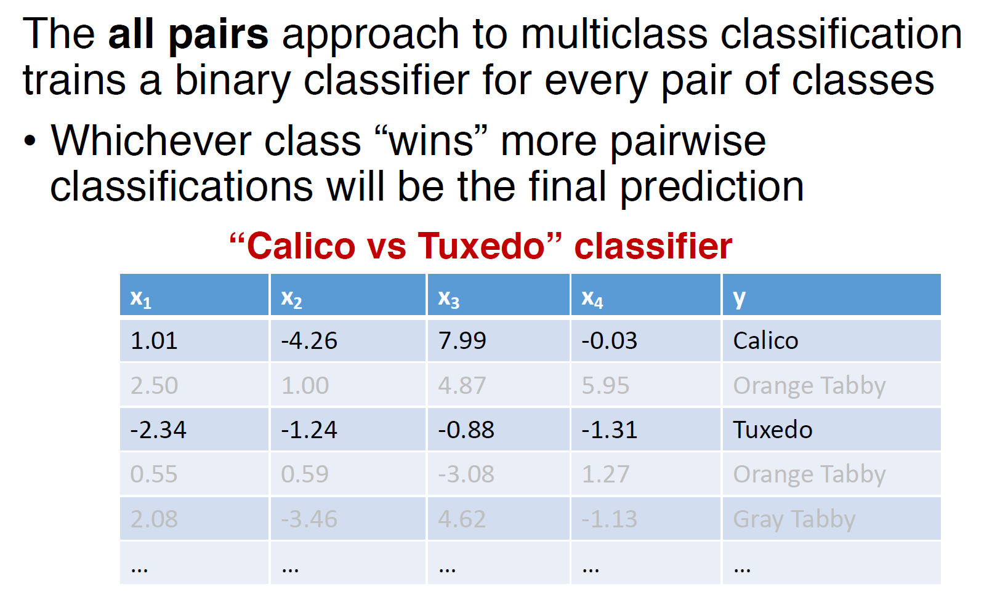
All Pairs (One vs One)
Notes:
We need to combine all the

Slide 18
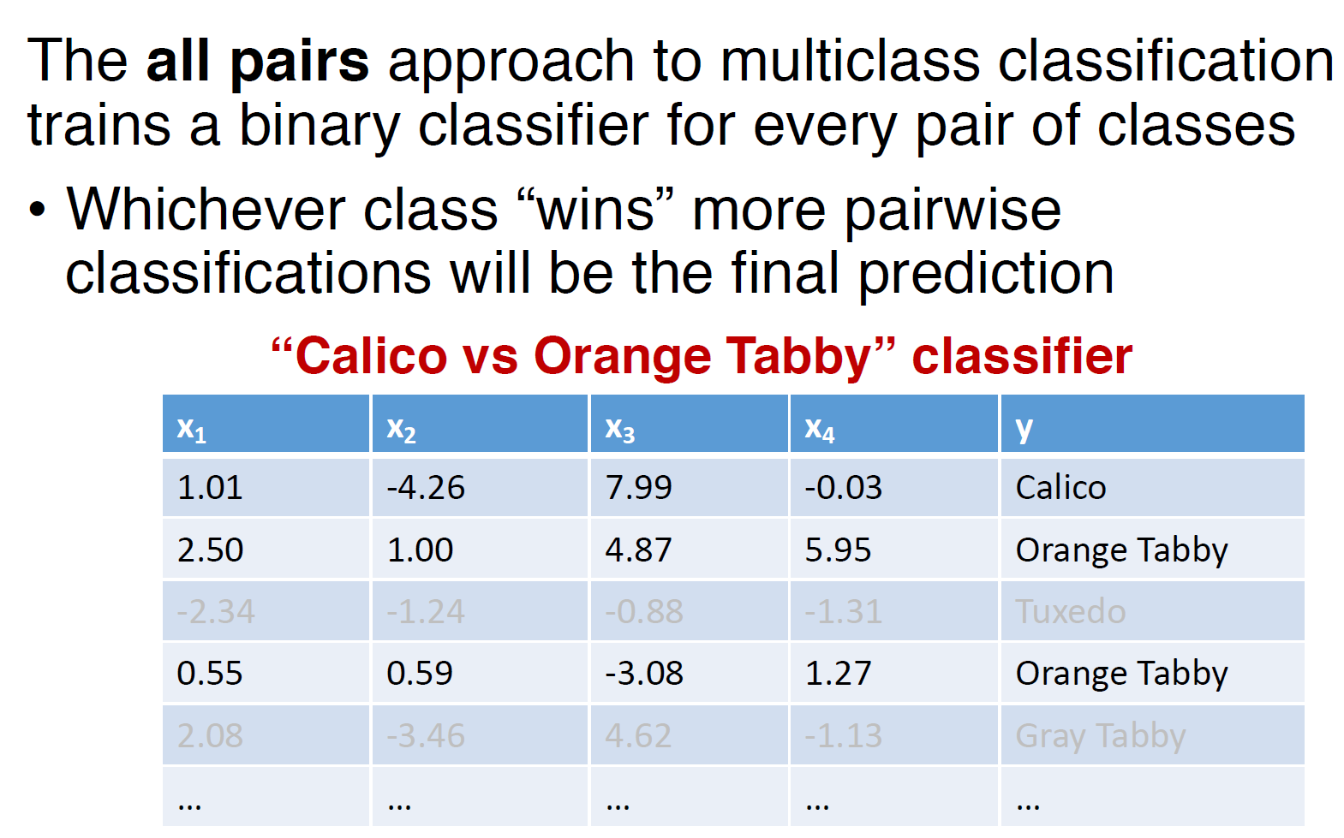
All Pairs (One vs One)
Notes:
We need to combine all the

Slide 19
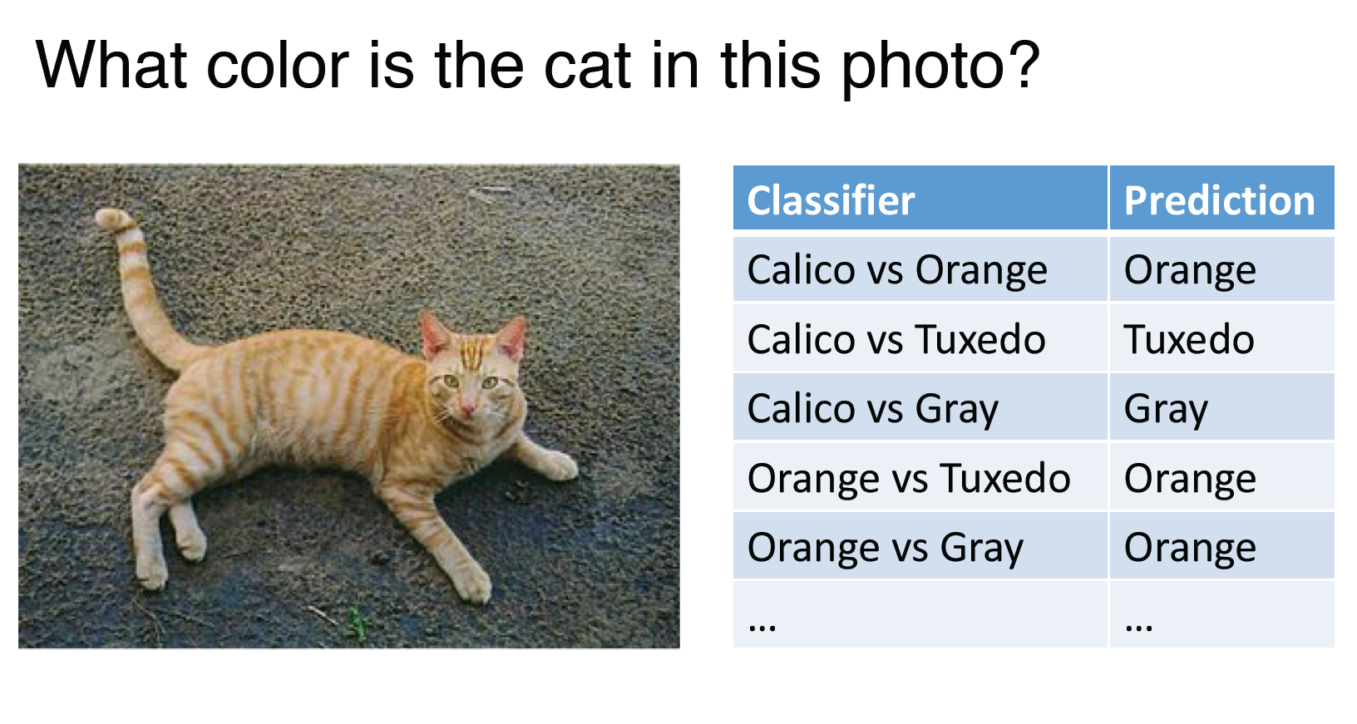
All Pairs (One vs One)
Notes:
We need to combine all the

Slide 20
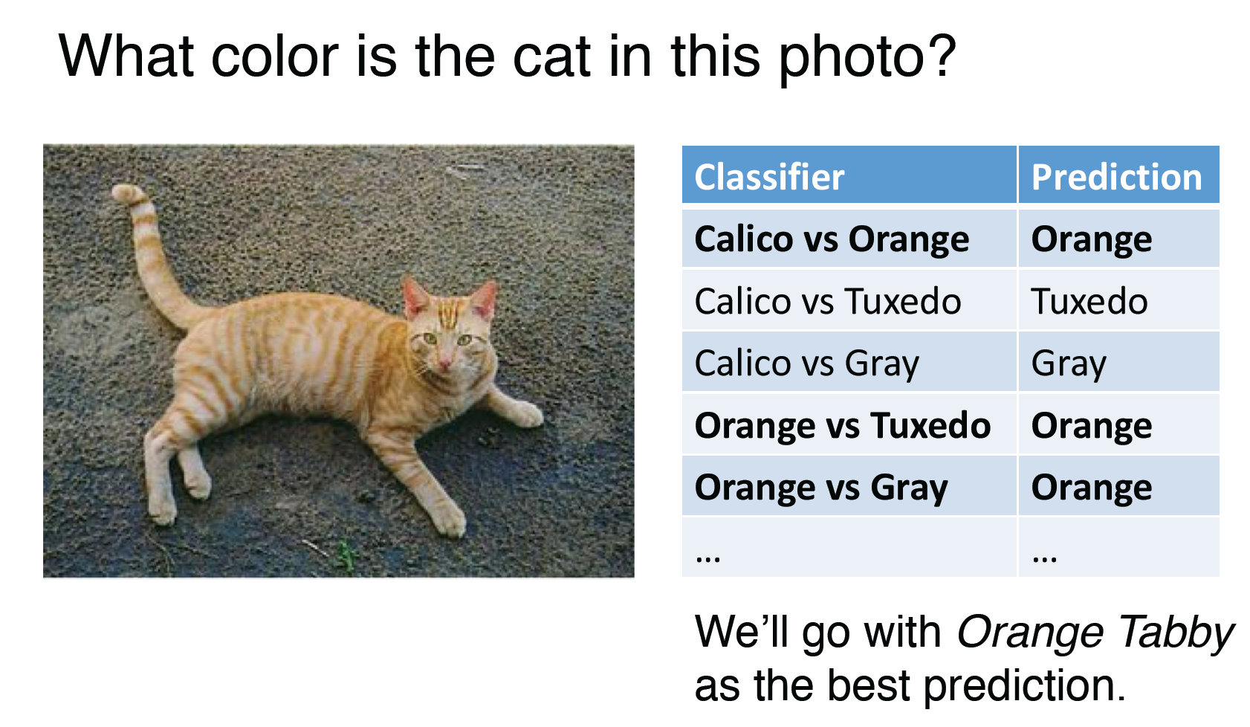
All Pairs (One vs One)
Notes:
We need to combine all the

Slide 21
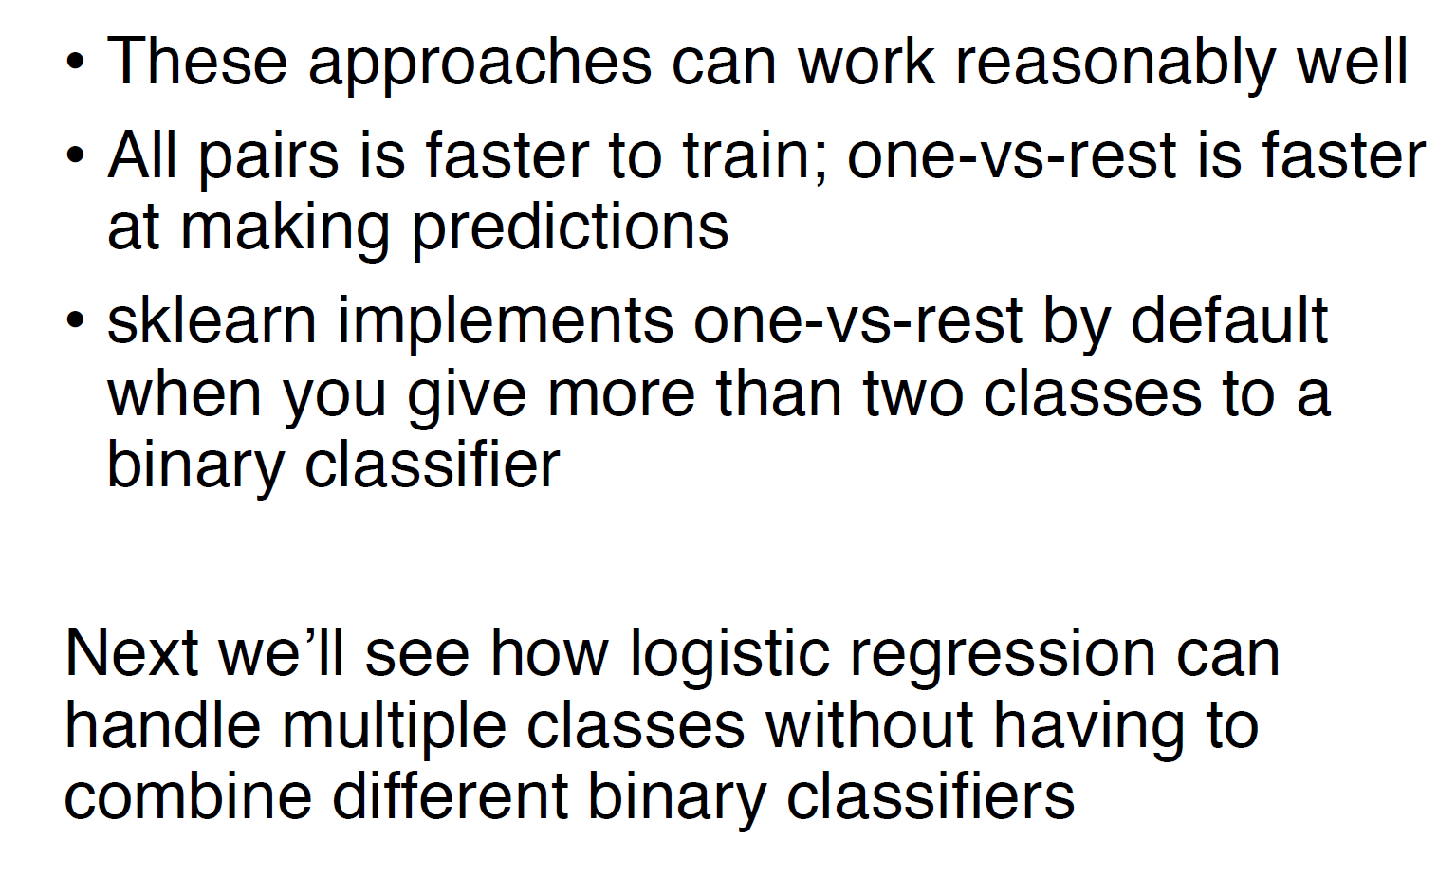
Multiclass Classification
Notes:
We need to combine all the

Slide 22
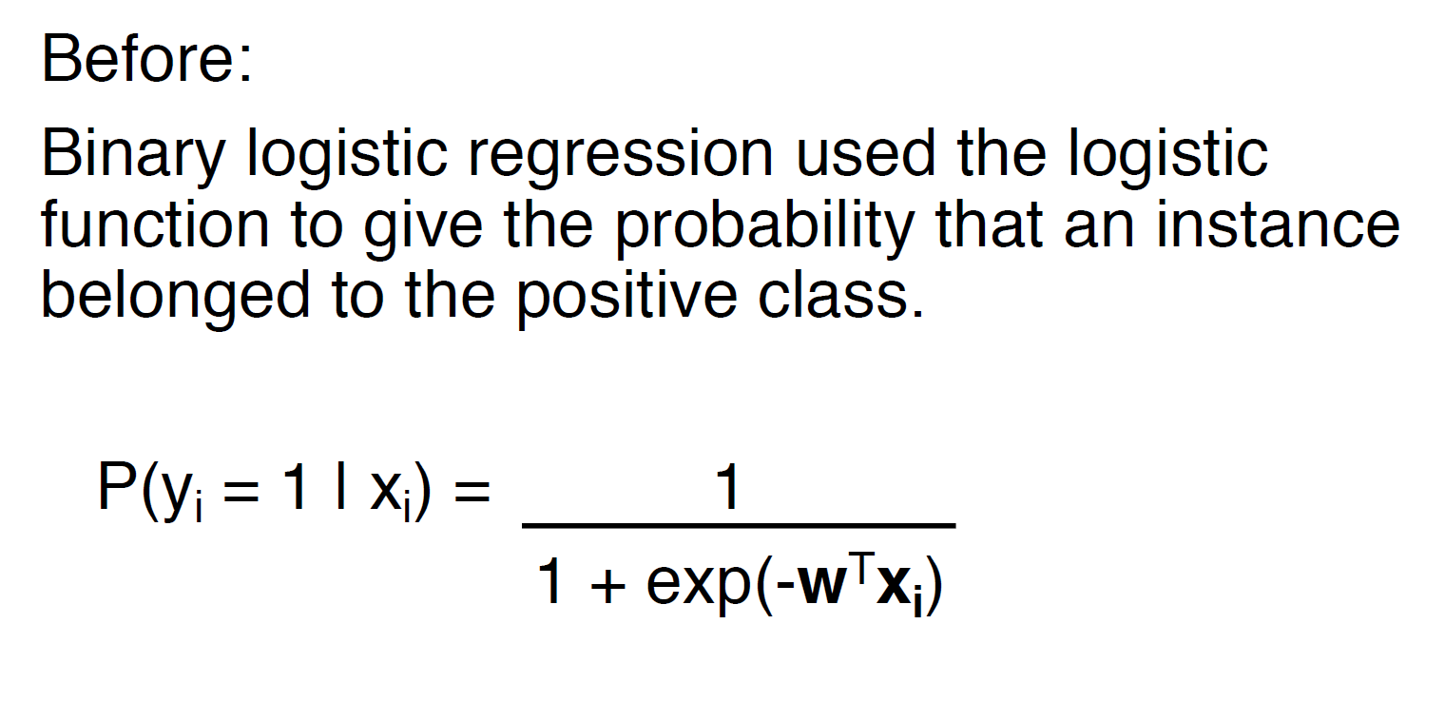
Logistic Regression
Notes:
We need to combine all the

Slide 23
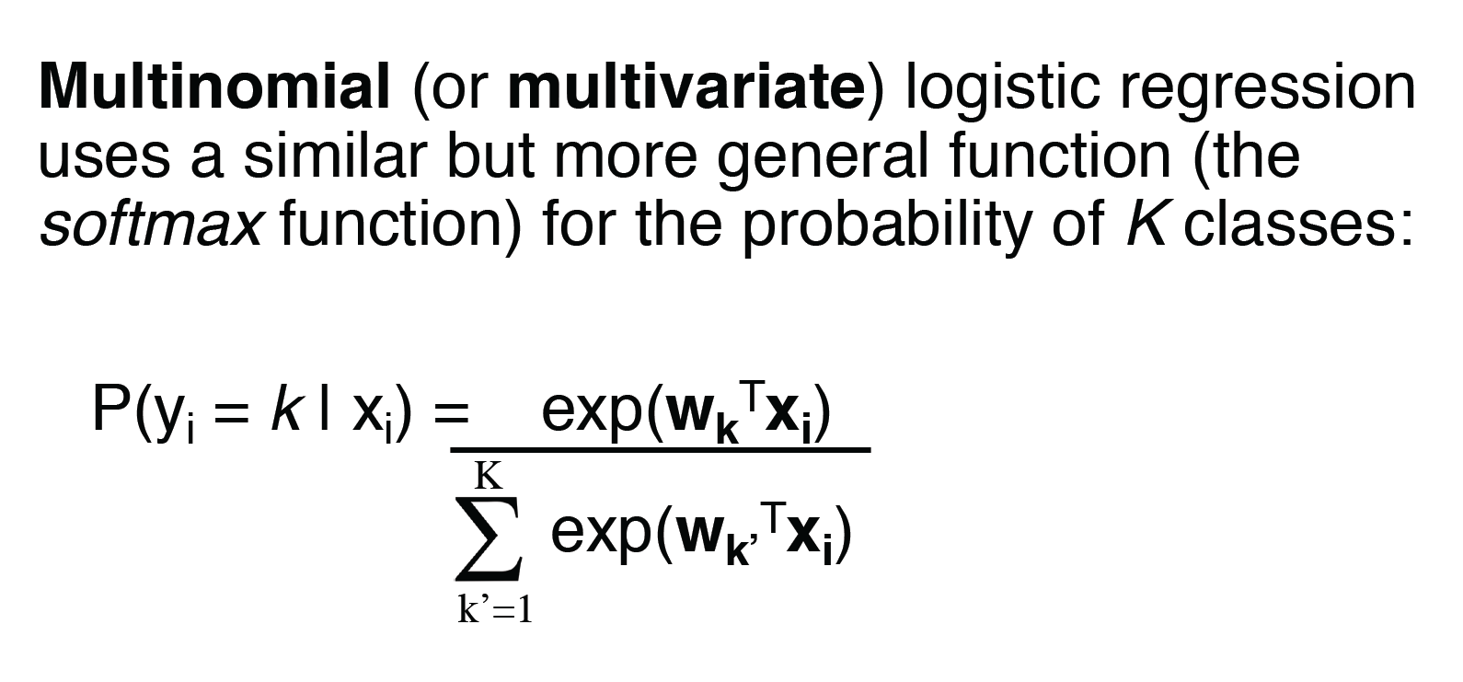
Logistic Regression
Notes:
We need to combine all the

Slide 24
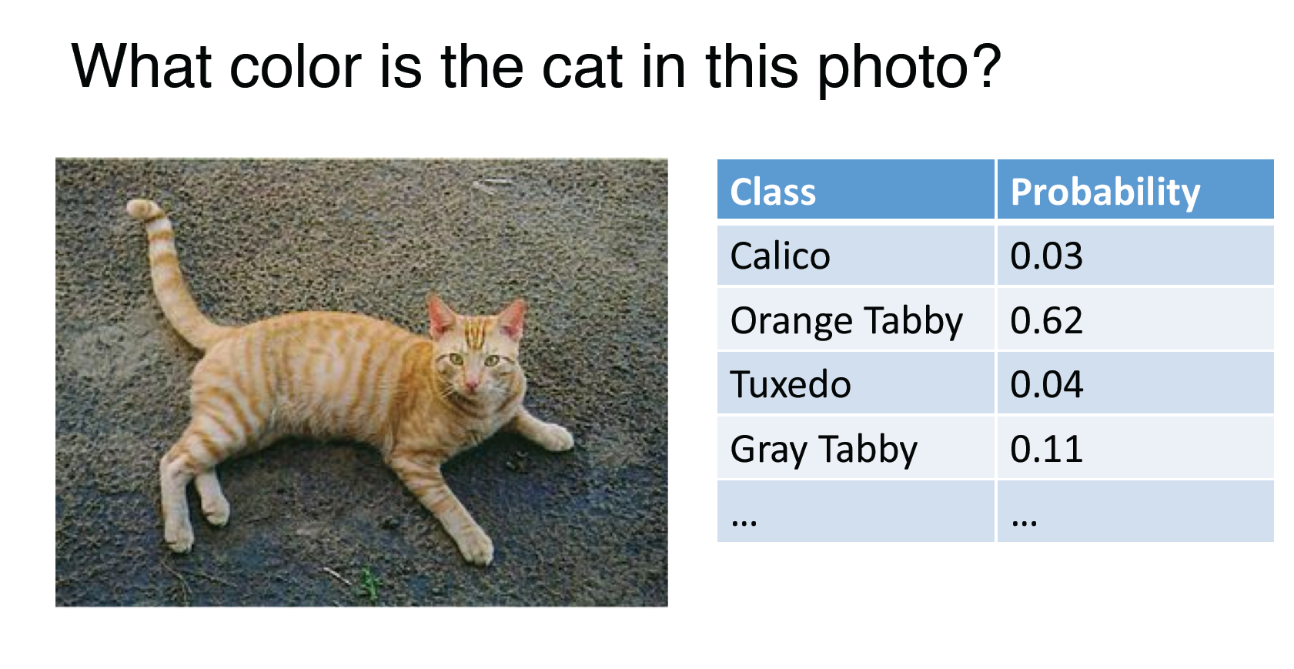
Logistic Regression
Notes:
We need to combine all the

Slide 25
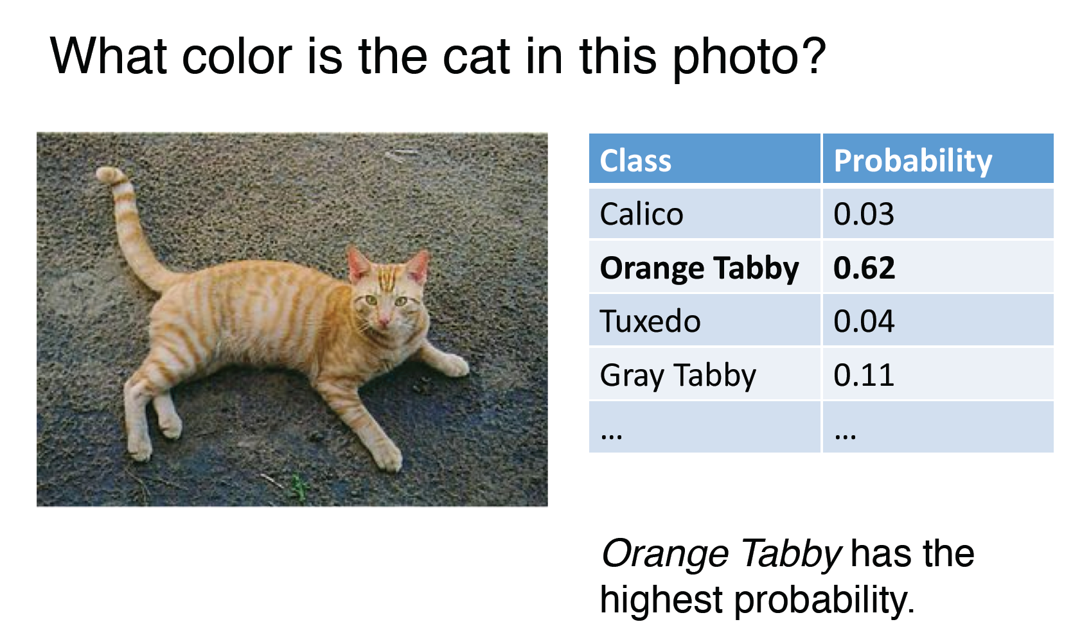
Logistic Regression
Notes:
We need to combine all the

Slide 26
Outline
Multiclass Classification
Decision Tree

Slide 27
Decision trees
Simple but powerful learning algorithm
One of the most widely used learning algorithms in Kaggle competitions
Useful information theoretic concepts (entropy, mutual information, etc.)
Notes:
We need to combine all the

Slide 28
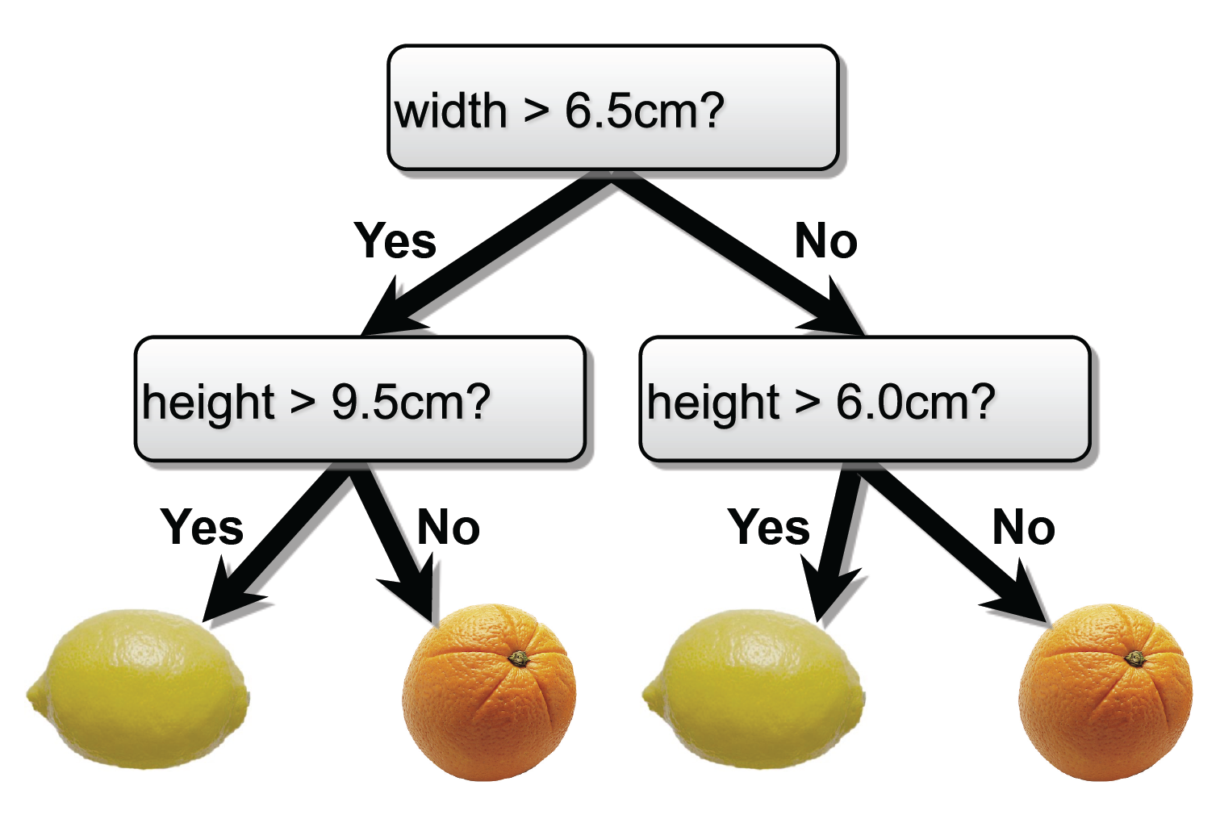
Decision trees
Notes:
We need to combine all the

Slide 29
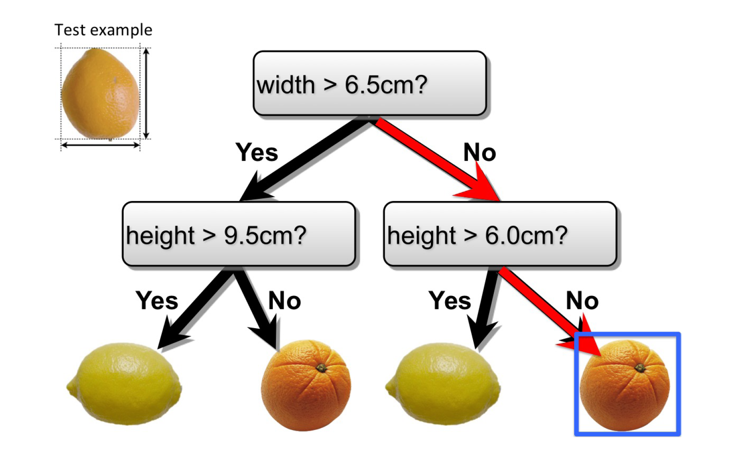
Decision trees
Notes:
We need to combine all the

Slide 30
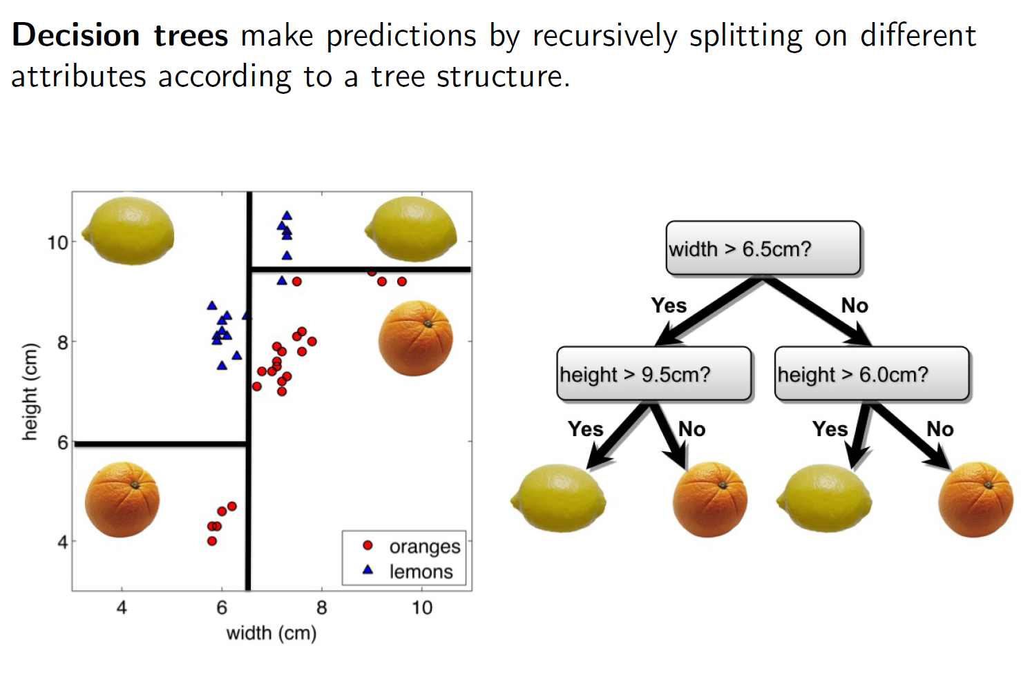
Decision trees
Notes:
We need to combine all the

Slide 31
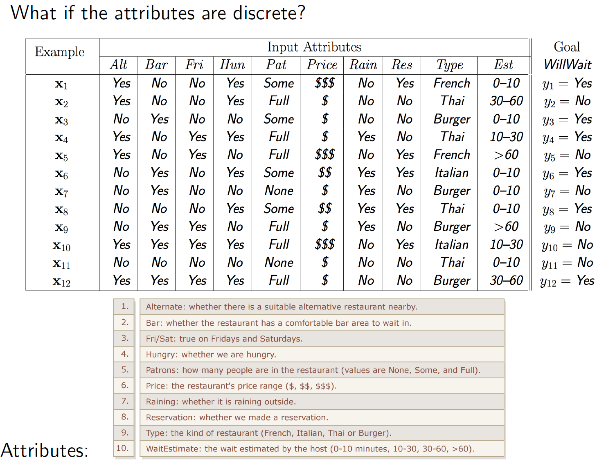
Decision trees
Notes:
We need to combine all the

Slide 32
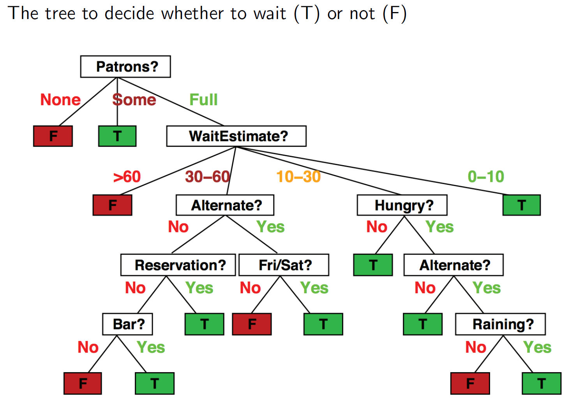
Decision trees
Notes:
We need to combine all the

Slide 33
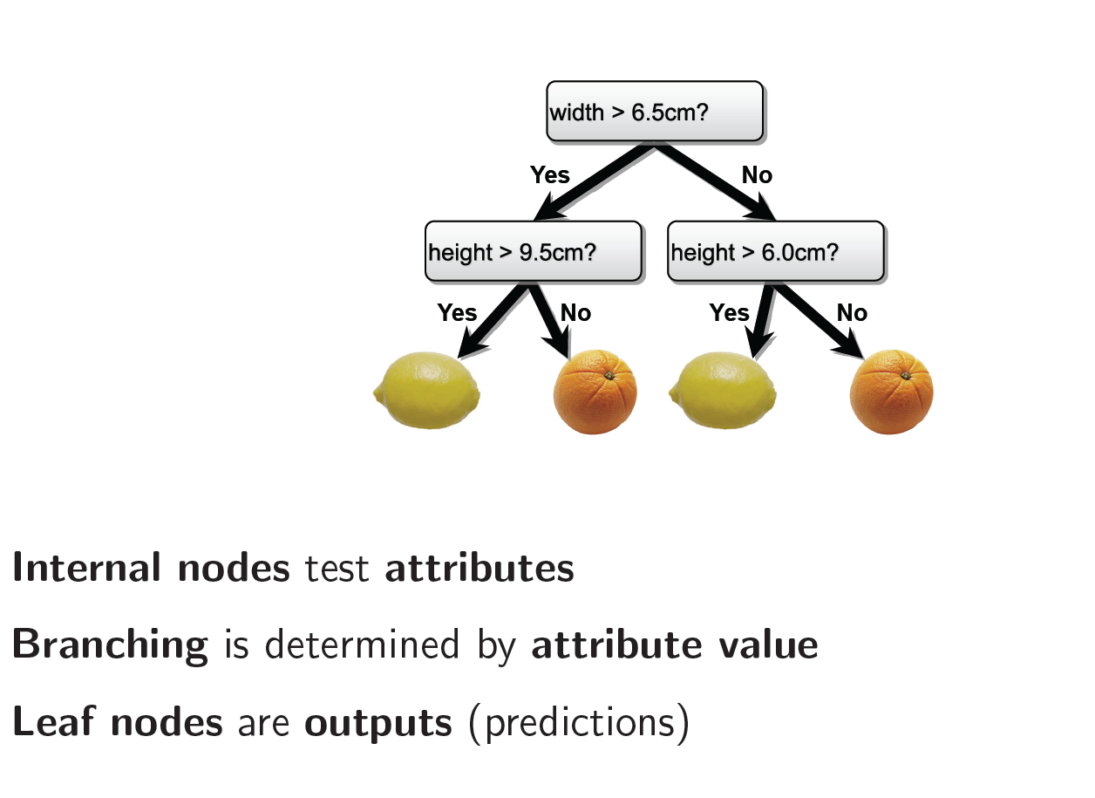
Decision trees
Notes:
We need to combine all the

Slide 34
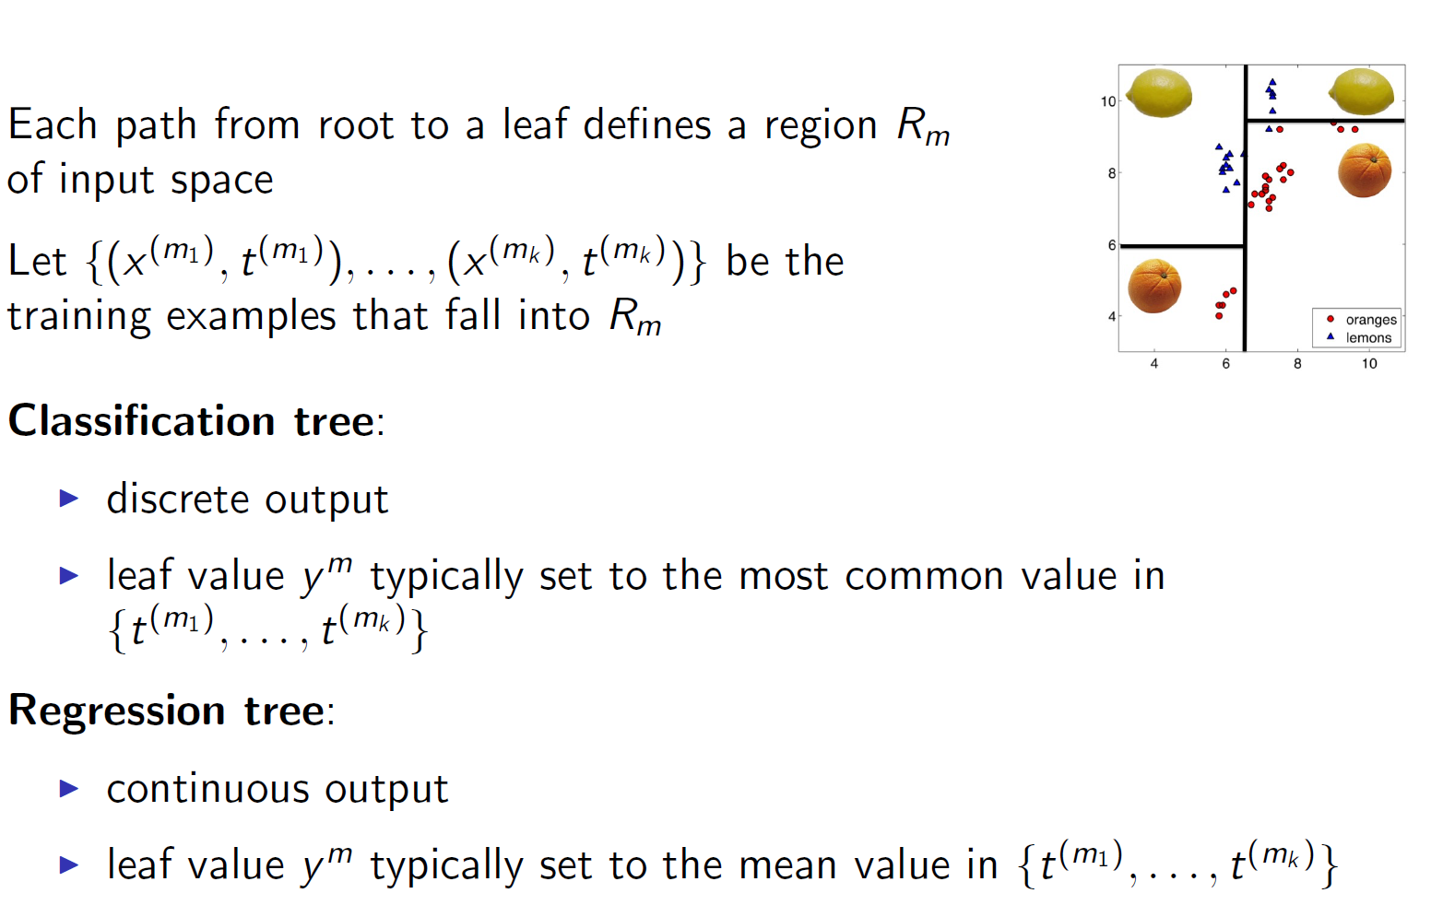
Decision trees: Classification and Regression
Notes:
We need to combine all the

Slide 35
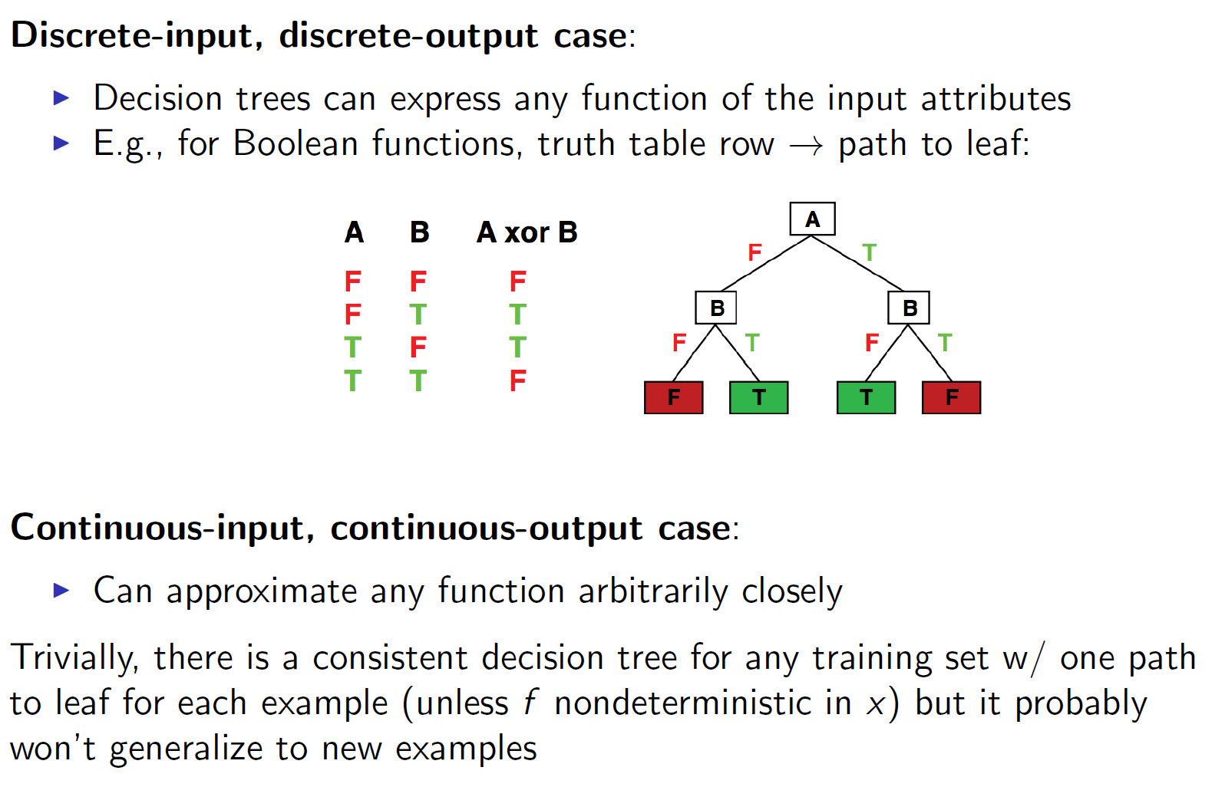
Decision trees
Notes:
We need to combine all the

Slide 36
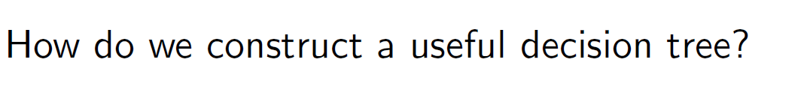
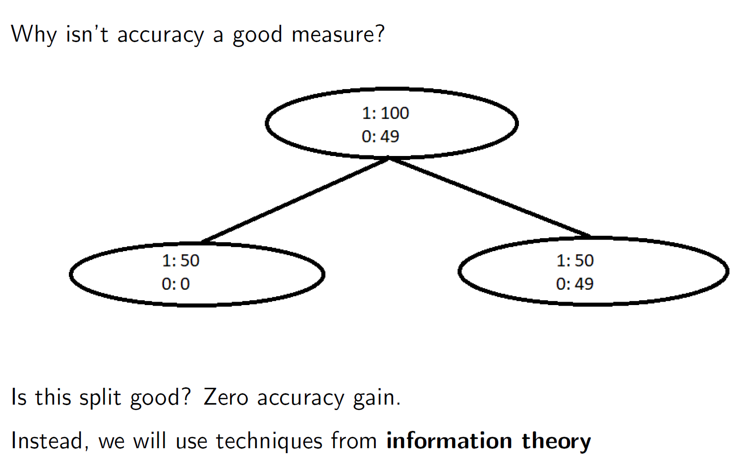
Decision trees
Notes:
We need to combine all the

Slide 37
Choosing a Good Split
Which attribute is better to split on ?
Deterministic: good (all are true or false; just one class in the leaf)
Uniform distribution: bad (all classes in leaf equally probable)
What about distribution in between?
Notes:
We need to combine all the

Slide 38
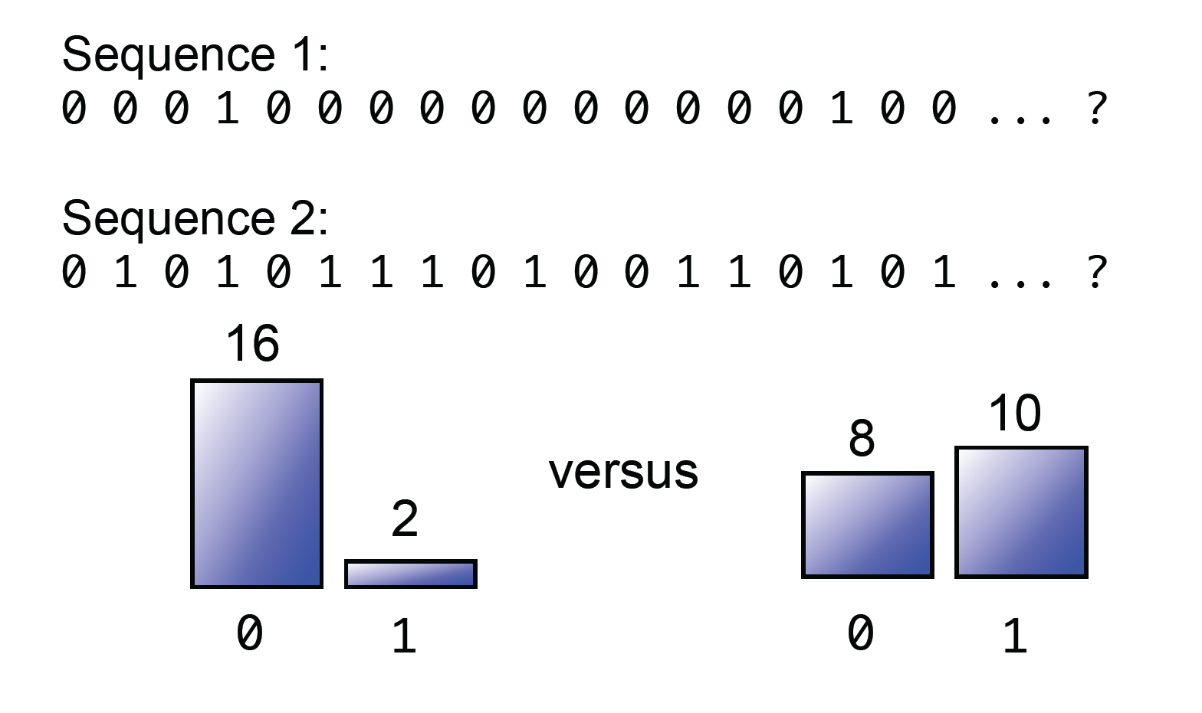
We Flip Two Different Coins
Notes:
We need to combine all the

Slide 39
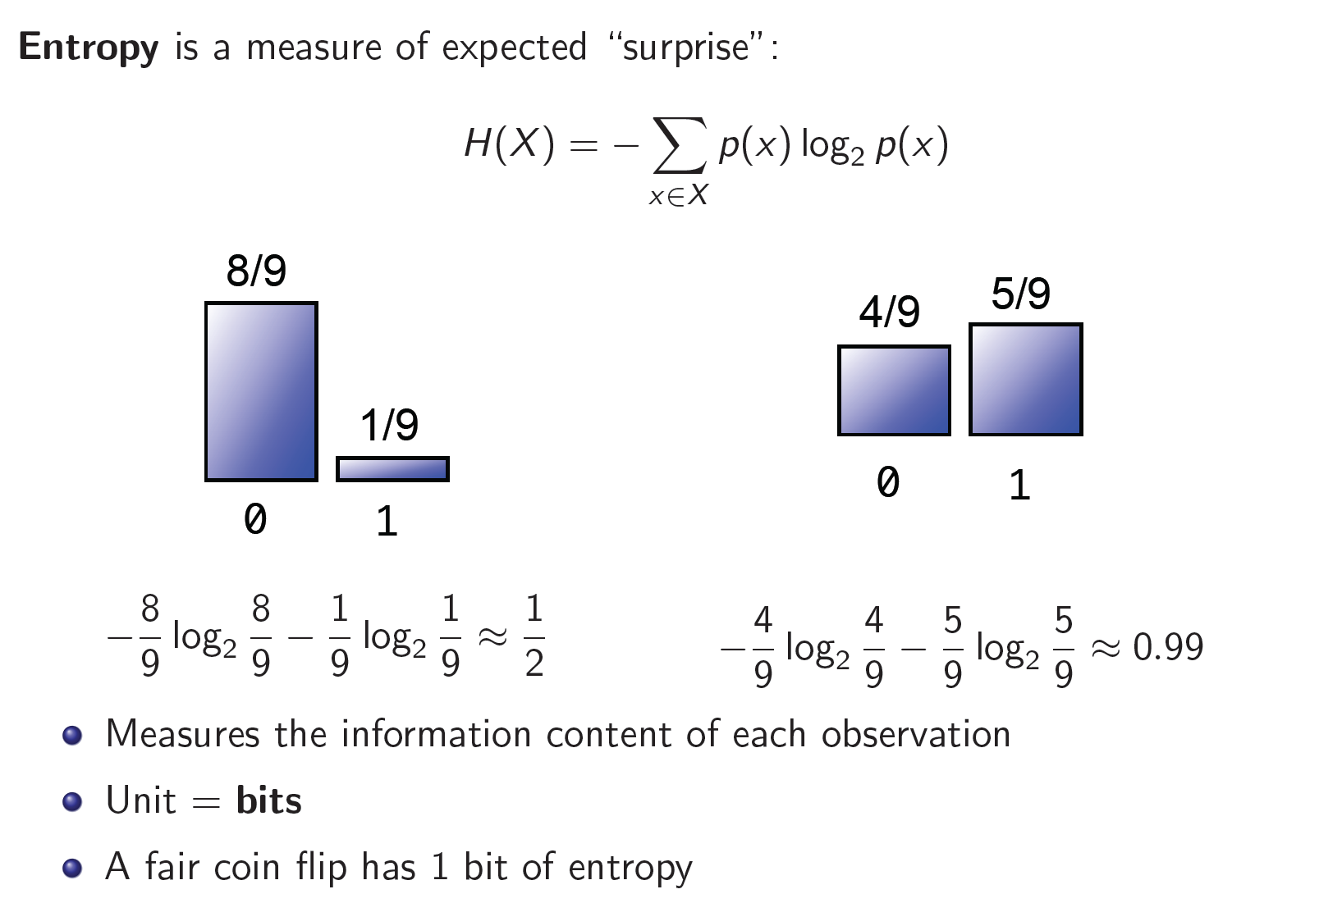
Quantifying Uncertainty
Notes:
We need to combine all the

Slide 40
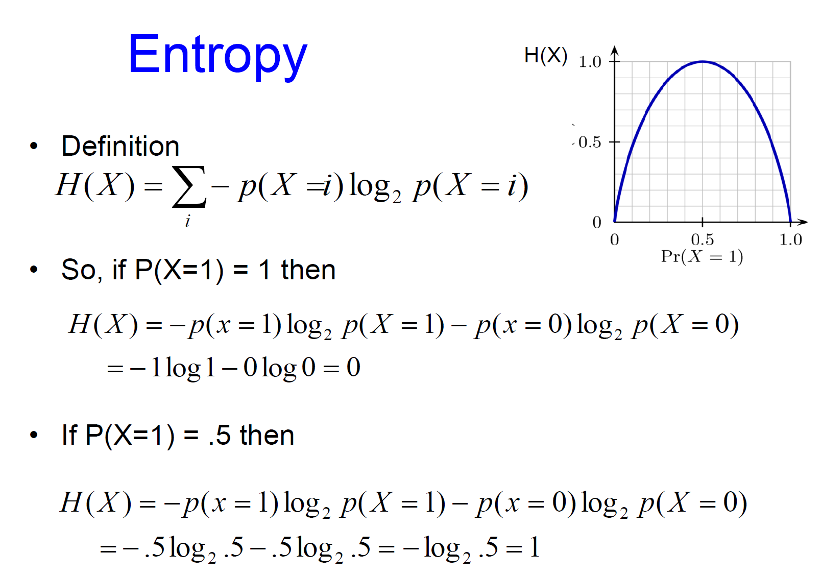
Entropy
Notes:
We need to combine all the

Slide 41
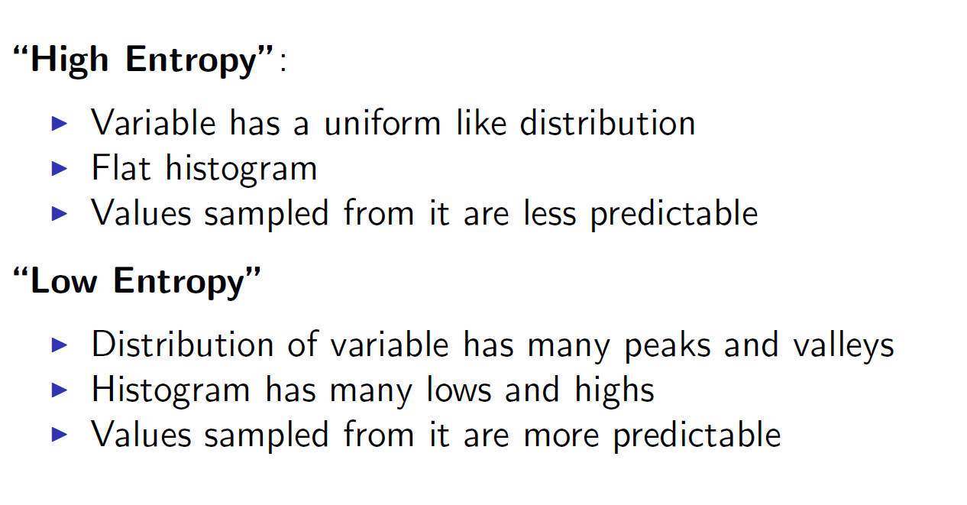
Quantifying Uncertainty
Notes:
We need to combine all the

Slide 42
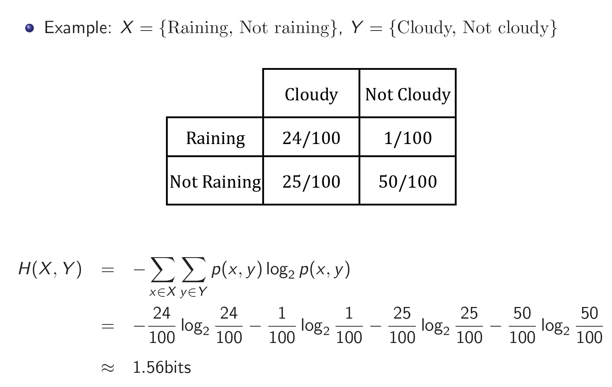
Entropy of a Joint Distribution
Notes:
We need to combine all the

Slide 43
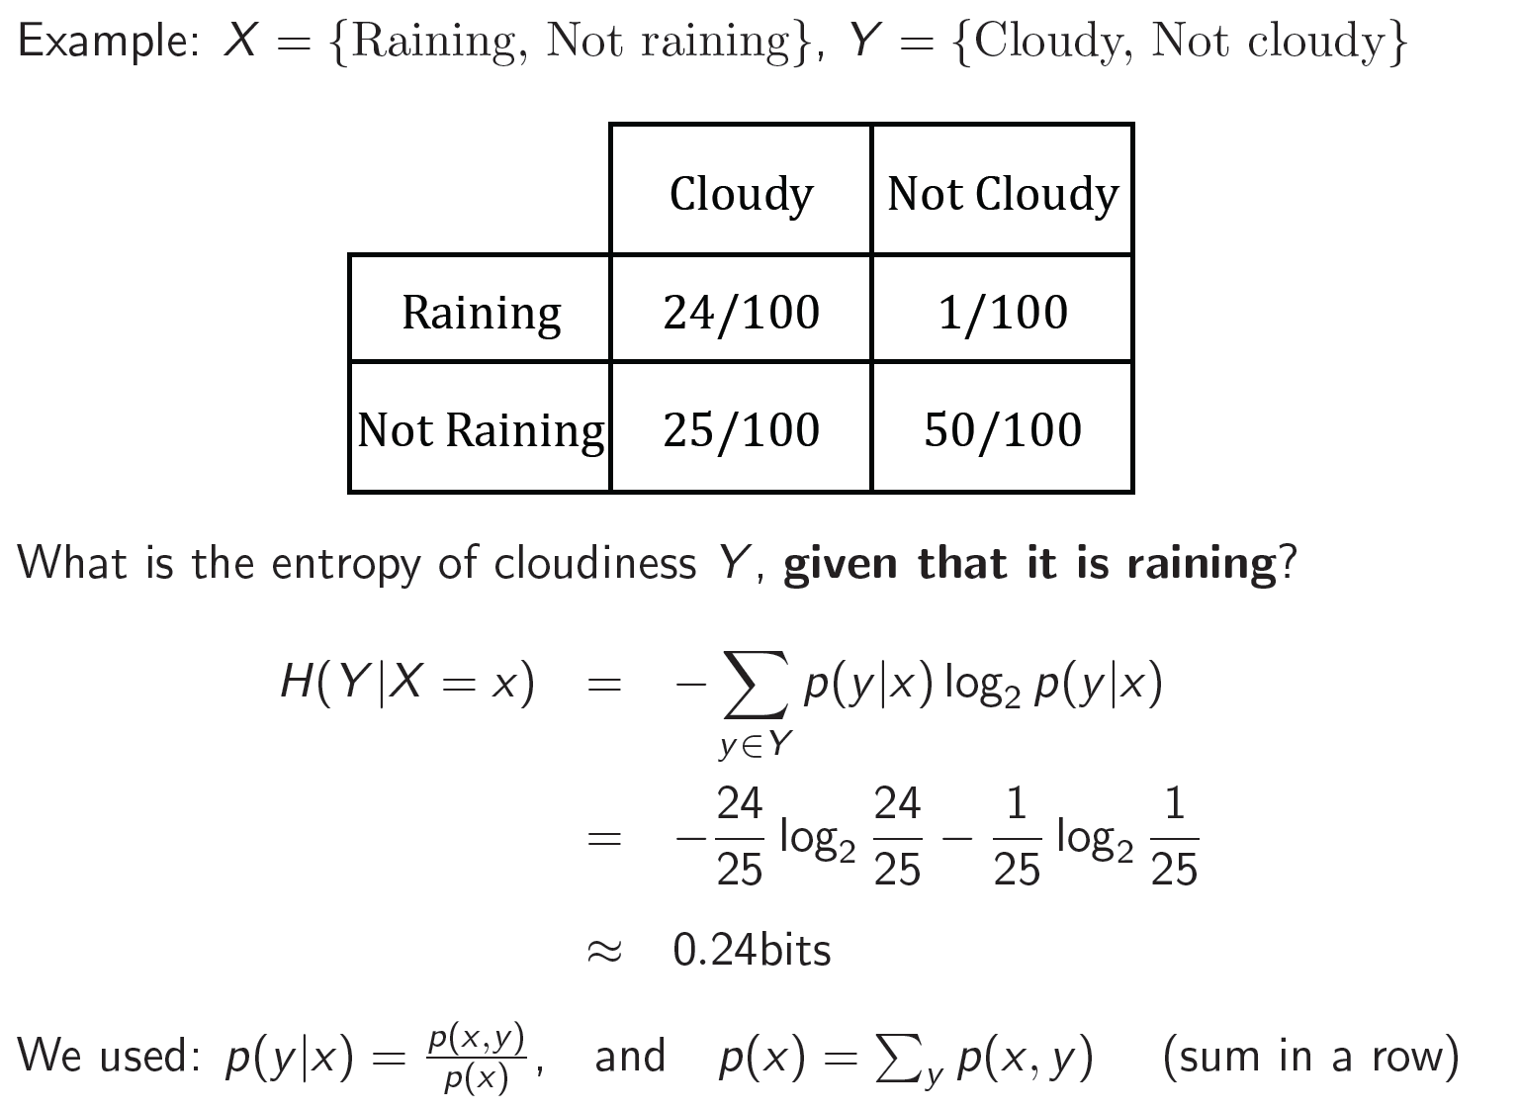
Specific Conditional Entropy
Notes:
We need to combine all the

Slide 44
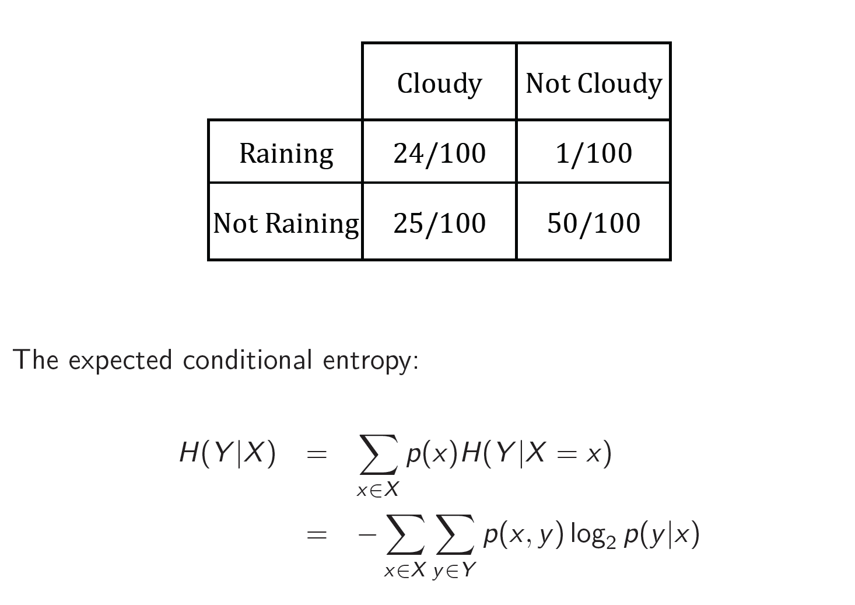
Conditional Entropy
Notes:
We need to combine all the

Slide 45
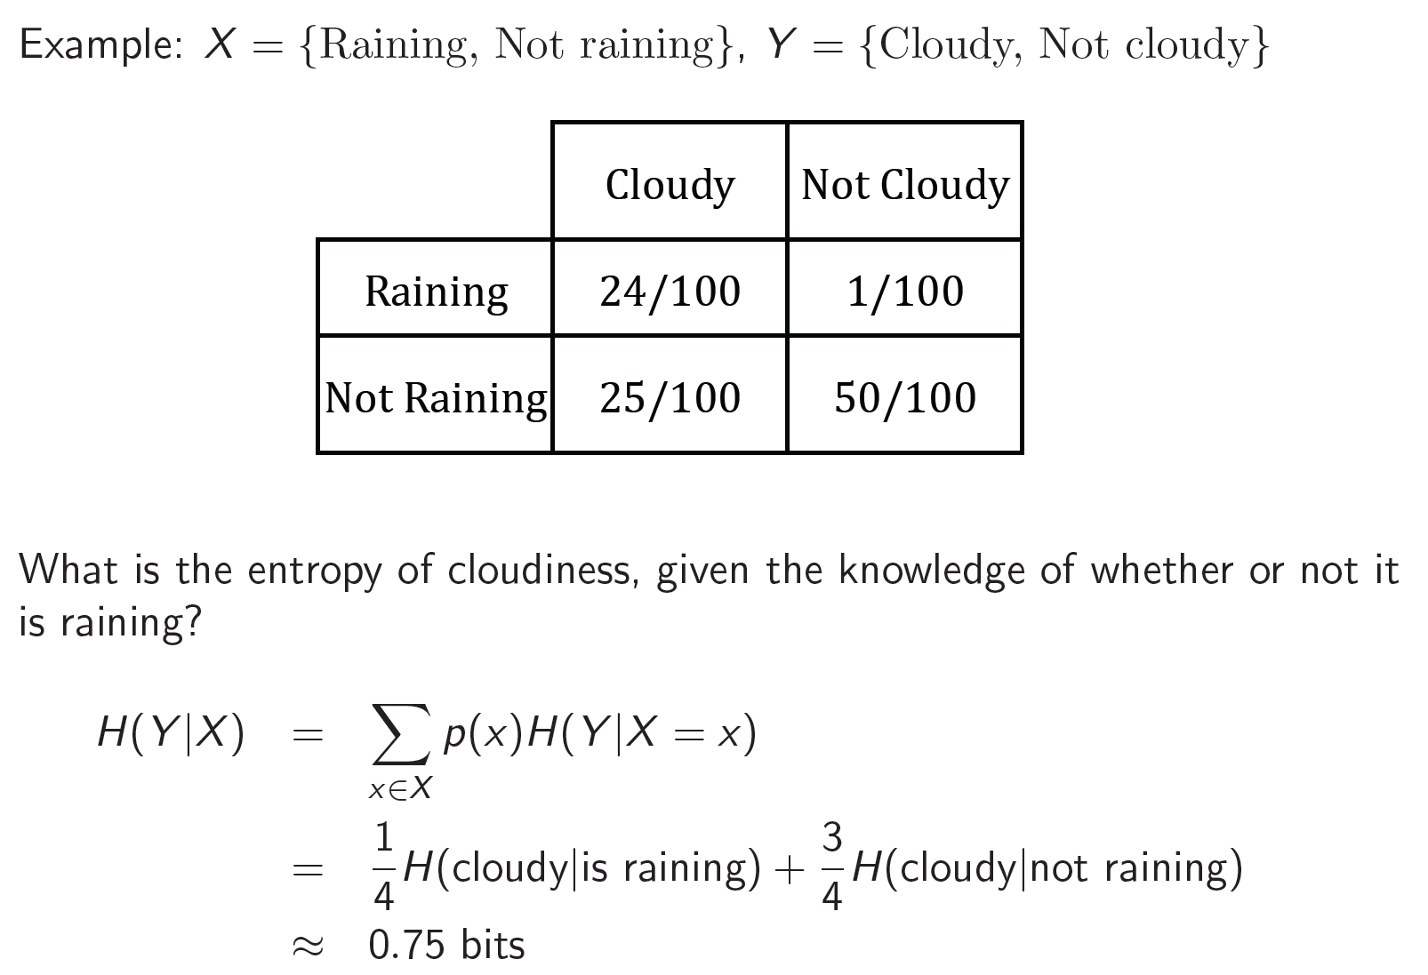
Conditional Entropy
Notes:
We need to combine all the

Slide 46
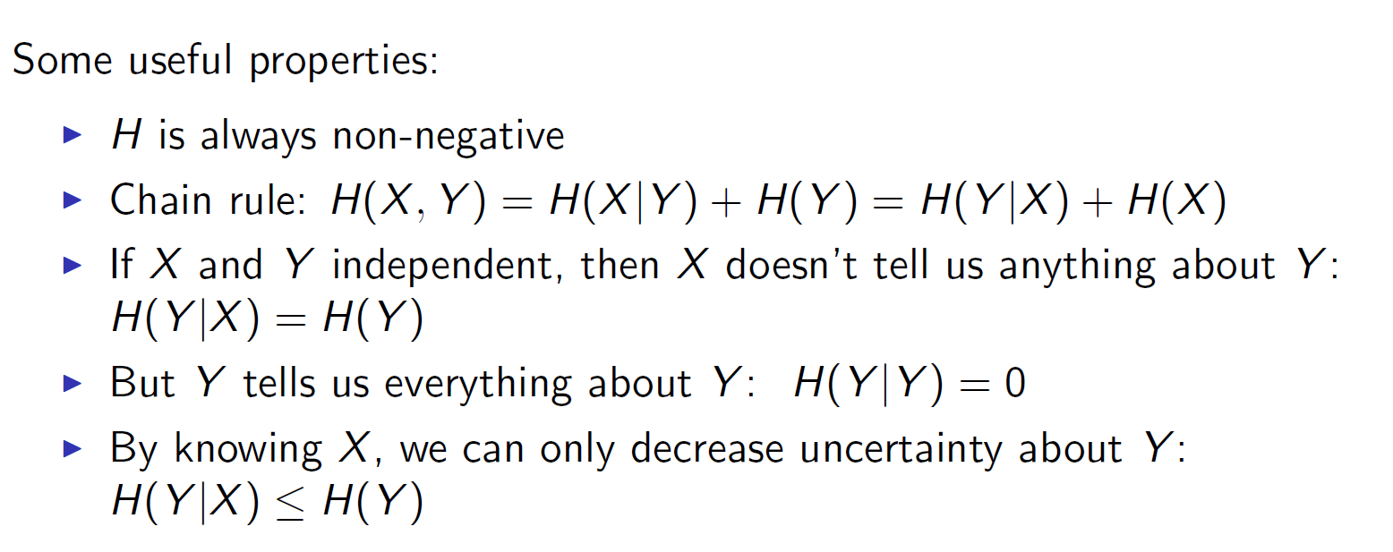
Conditional Entropy
Notes:
We need to combine all the

Slide 47
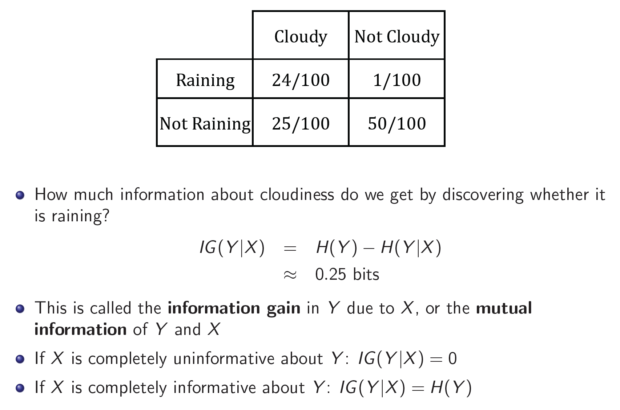
Information Gain
Notes:
We need to combine all the

Slide 48
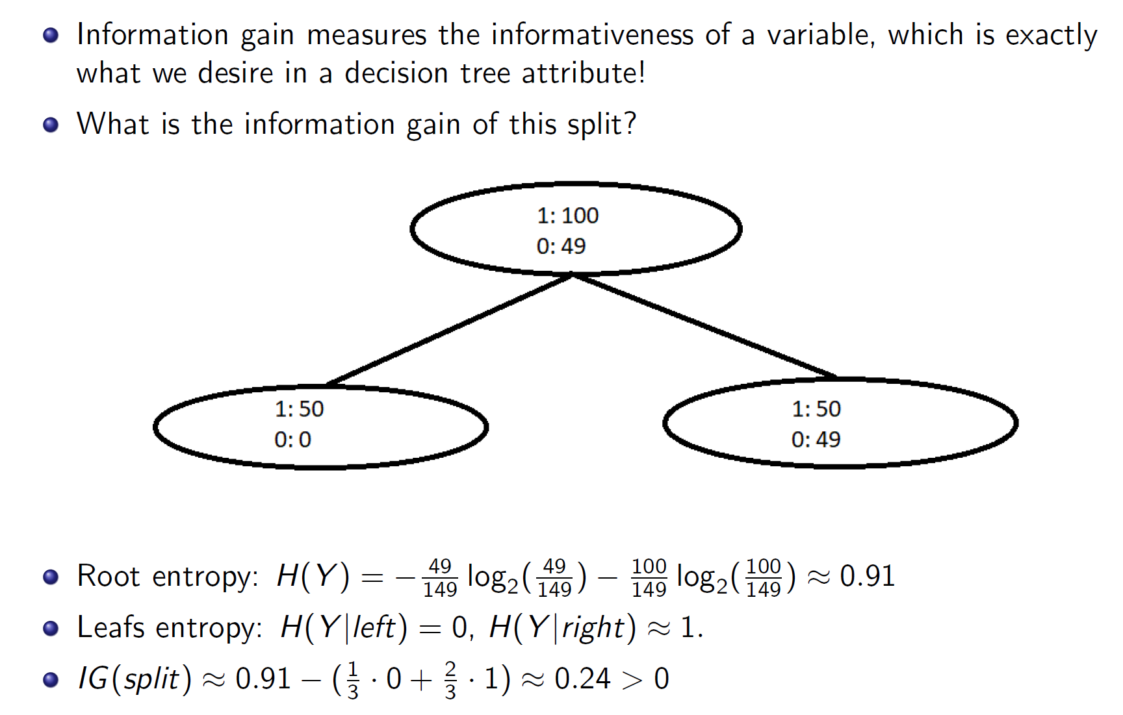
Revisiting Our Original Example
Notes:
We need to combine all the

Slide 49
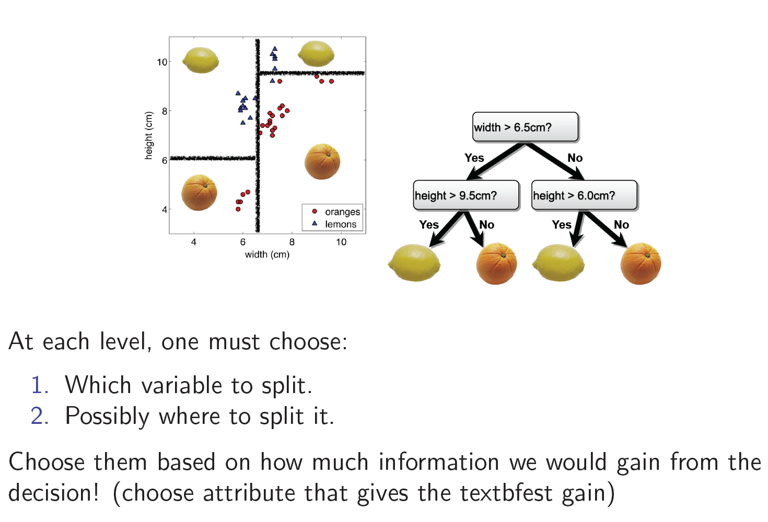
Constructing Decision Trees
largest
Notes:
We need to combine all the

Slide 50
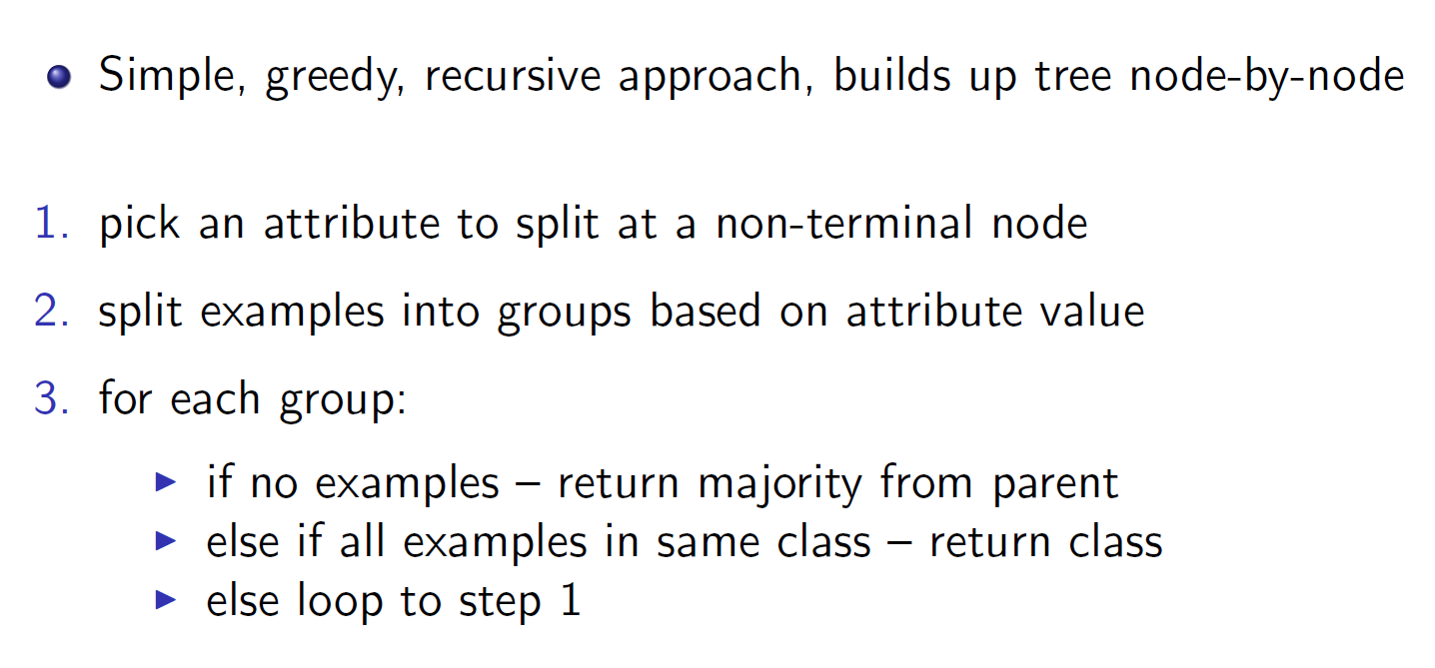
Decision Tree Construction Algorithm
Notes:
We need to combine all the

Slide 51
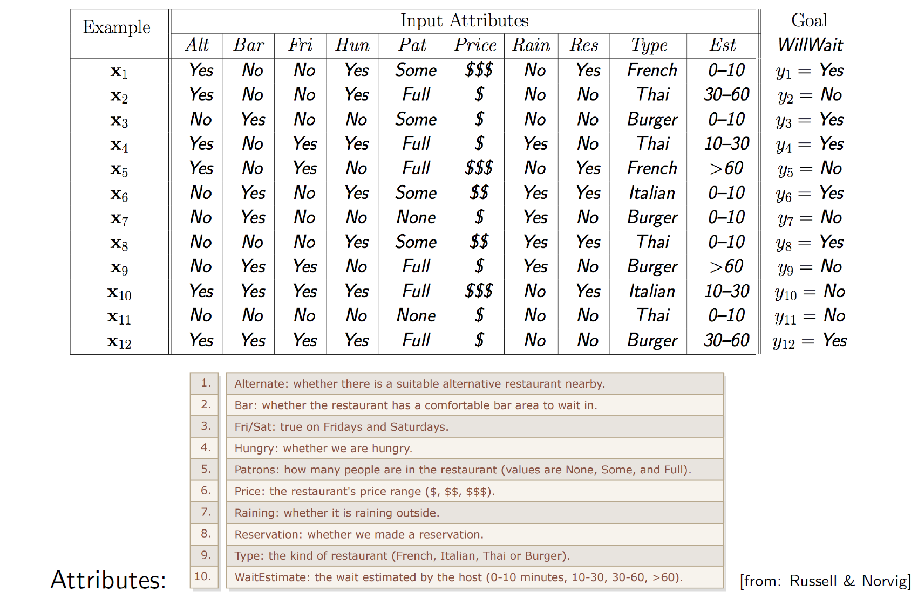
Back to Our Example
Notes:
We need to combine all the

Slide 52
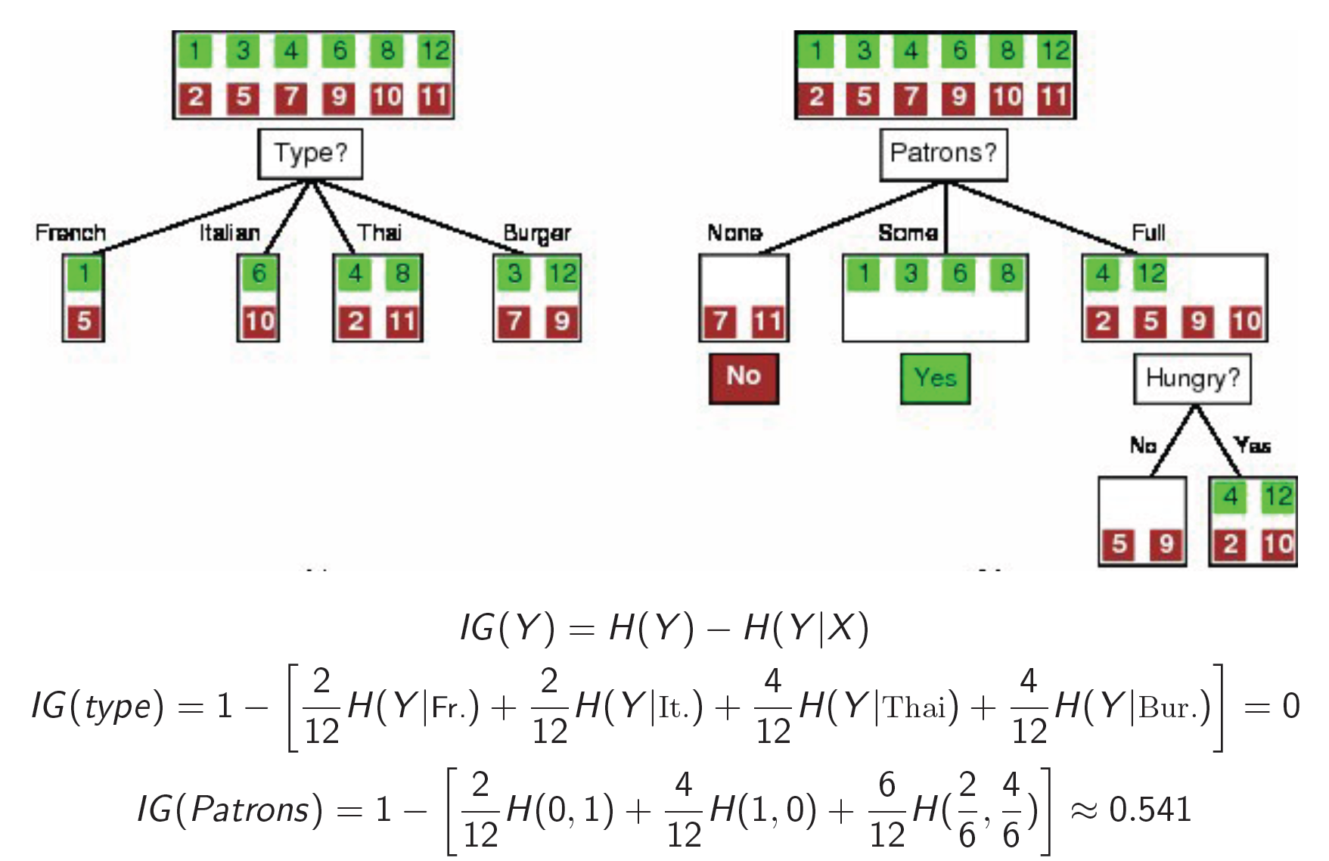
Attribute Selection
Notes:
We need to combine all the

Slide 53
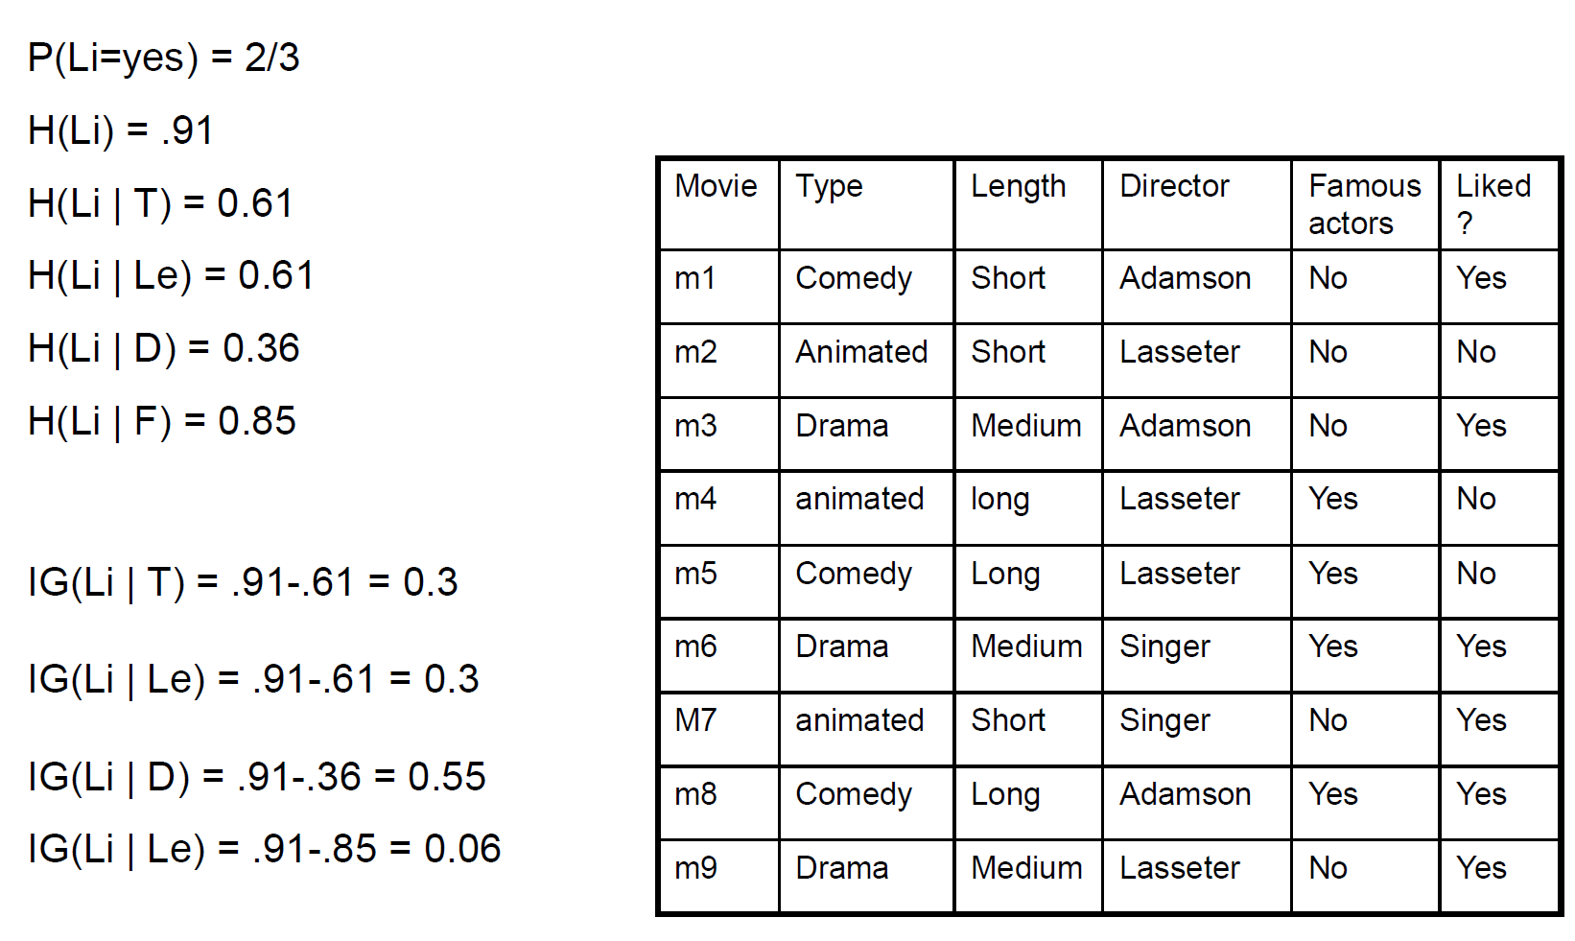
Example: Root attribute
Notes:
We need to combine all the

Slide 54
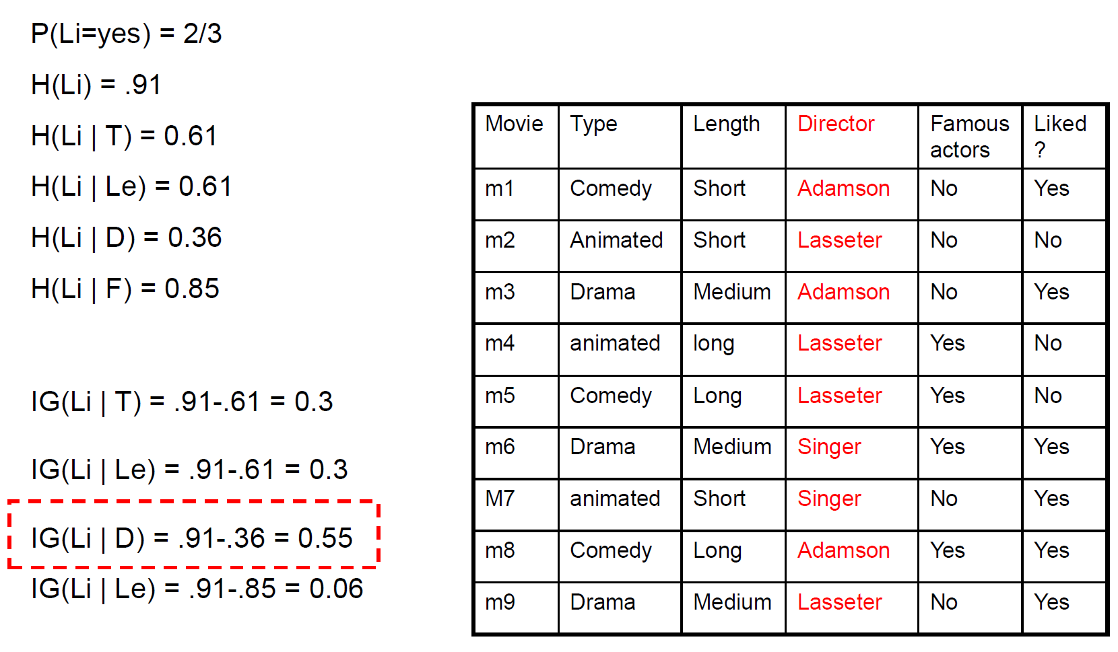
Example: Root attribute
Notes:
We need to combine all the

Slide 55
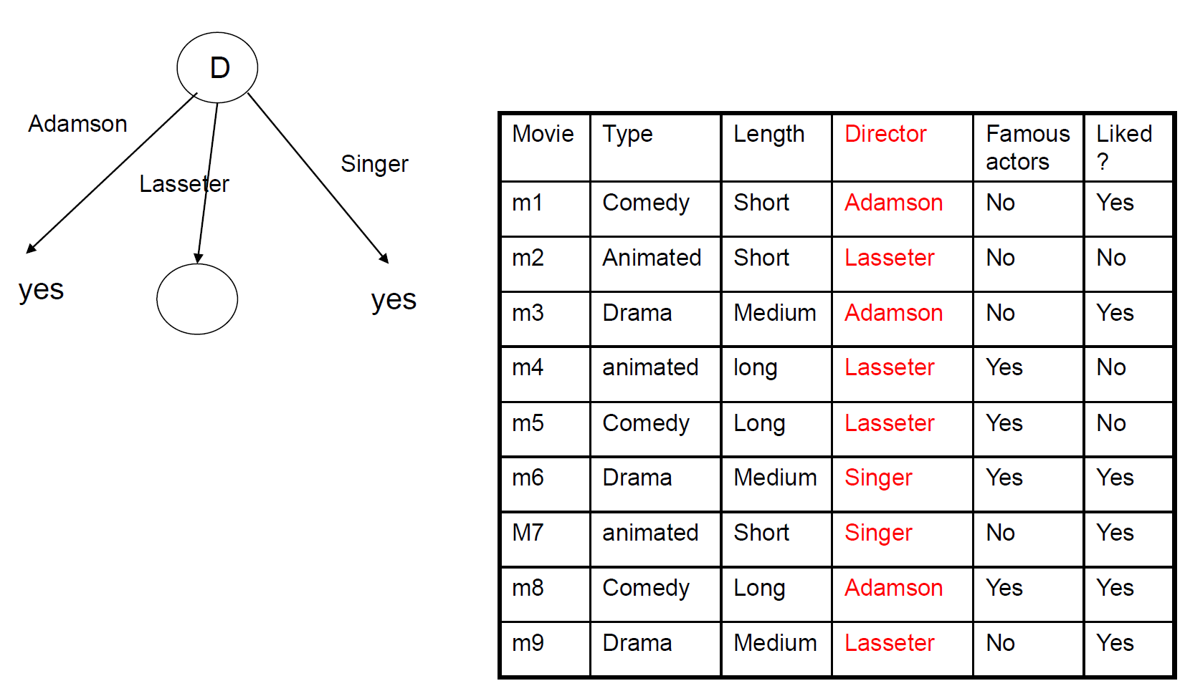
Building a tree
Notes:
We need to combine all the

Slide 56

Building a tree
Notes:
We need to combine all the

Slide 57

Building a tree
Notes:
We need to combine all the

Slide 58

Building a tree
Notes:
We need to combine all the

Slide 59

Building a tree
Notes:
We need to combine all the

Slide 60

Final tree
Notes:
We need to combine all the

Slide 61

What Makes a Good Tree
Notes:
We need to combine all the

Slide 62

Comparison to KNN
Notes:
We need to combine all the

Slide 63

Comparison to KNN
Notes:
We need to combine all the

